Slide 1
WHAT IS A BIOSTATISTICIAN TRYING TO PROVE? PROOF IN MEDICAL RESEARCH
Susan S. Ellenberg, Ph.D.
Department of Biostatistics and Epidemiology
Perelman School of Medicine, U Penn

Slide 2
Statistics is the science of uncertainty
Biostatistics is the application of statistics to biological problems
Many biostatisticians work in medical research

Slide 3
PROOF IN BIOSTATISTICS
Many biostatisticians develop theory, just as mathematicians do
Proofs usually relate to the validity of methods developed for applications
Analysis of data
Study design
Estimation
Modeling processes

Slide 4
BIOSTATISTICIANS AND PROOF IN MEDICAL RESEARCH
Much of what biostatisticians do is work with other scientists to design and analyze studies to answer questions of interest
The job of the biostatistician is to ensure that the study is designed and analyzed in a way that the results are persuasive and that they can support decision-making
Nota bene: “persuasive” and “can support decision-making” are inherently subjective

Slide 5
TYPES OF DECISIONS
Government decisions
Organizational decisions
Personal decisions

Slide 6
GOVERNMENT DECISIONS
Should a medical treatment be approved for marketing?
Should an approved treatment be withdrawn or subject to more restrictions?
Should certain pesticides be banned?
Should a new vaccine be recommended for widespread use?
Should our community fluoridate its water?

Slide 7
ORGANIZATIONAL DECISIONS
What treatments will an insurance company cover?
What treatment strategies will be recommended by medical societies?
Will a hospital purchase the latest diagnostic scanner?

Slide 8
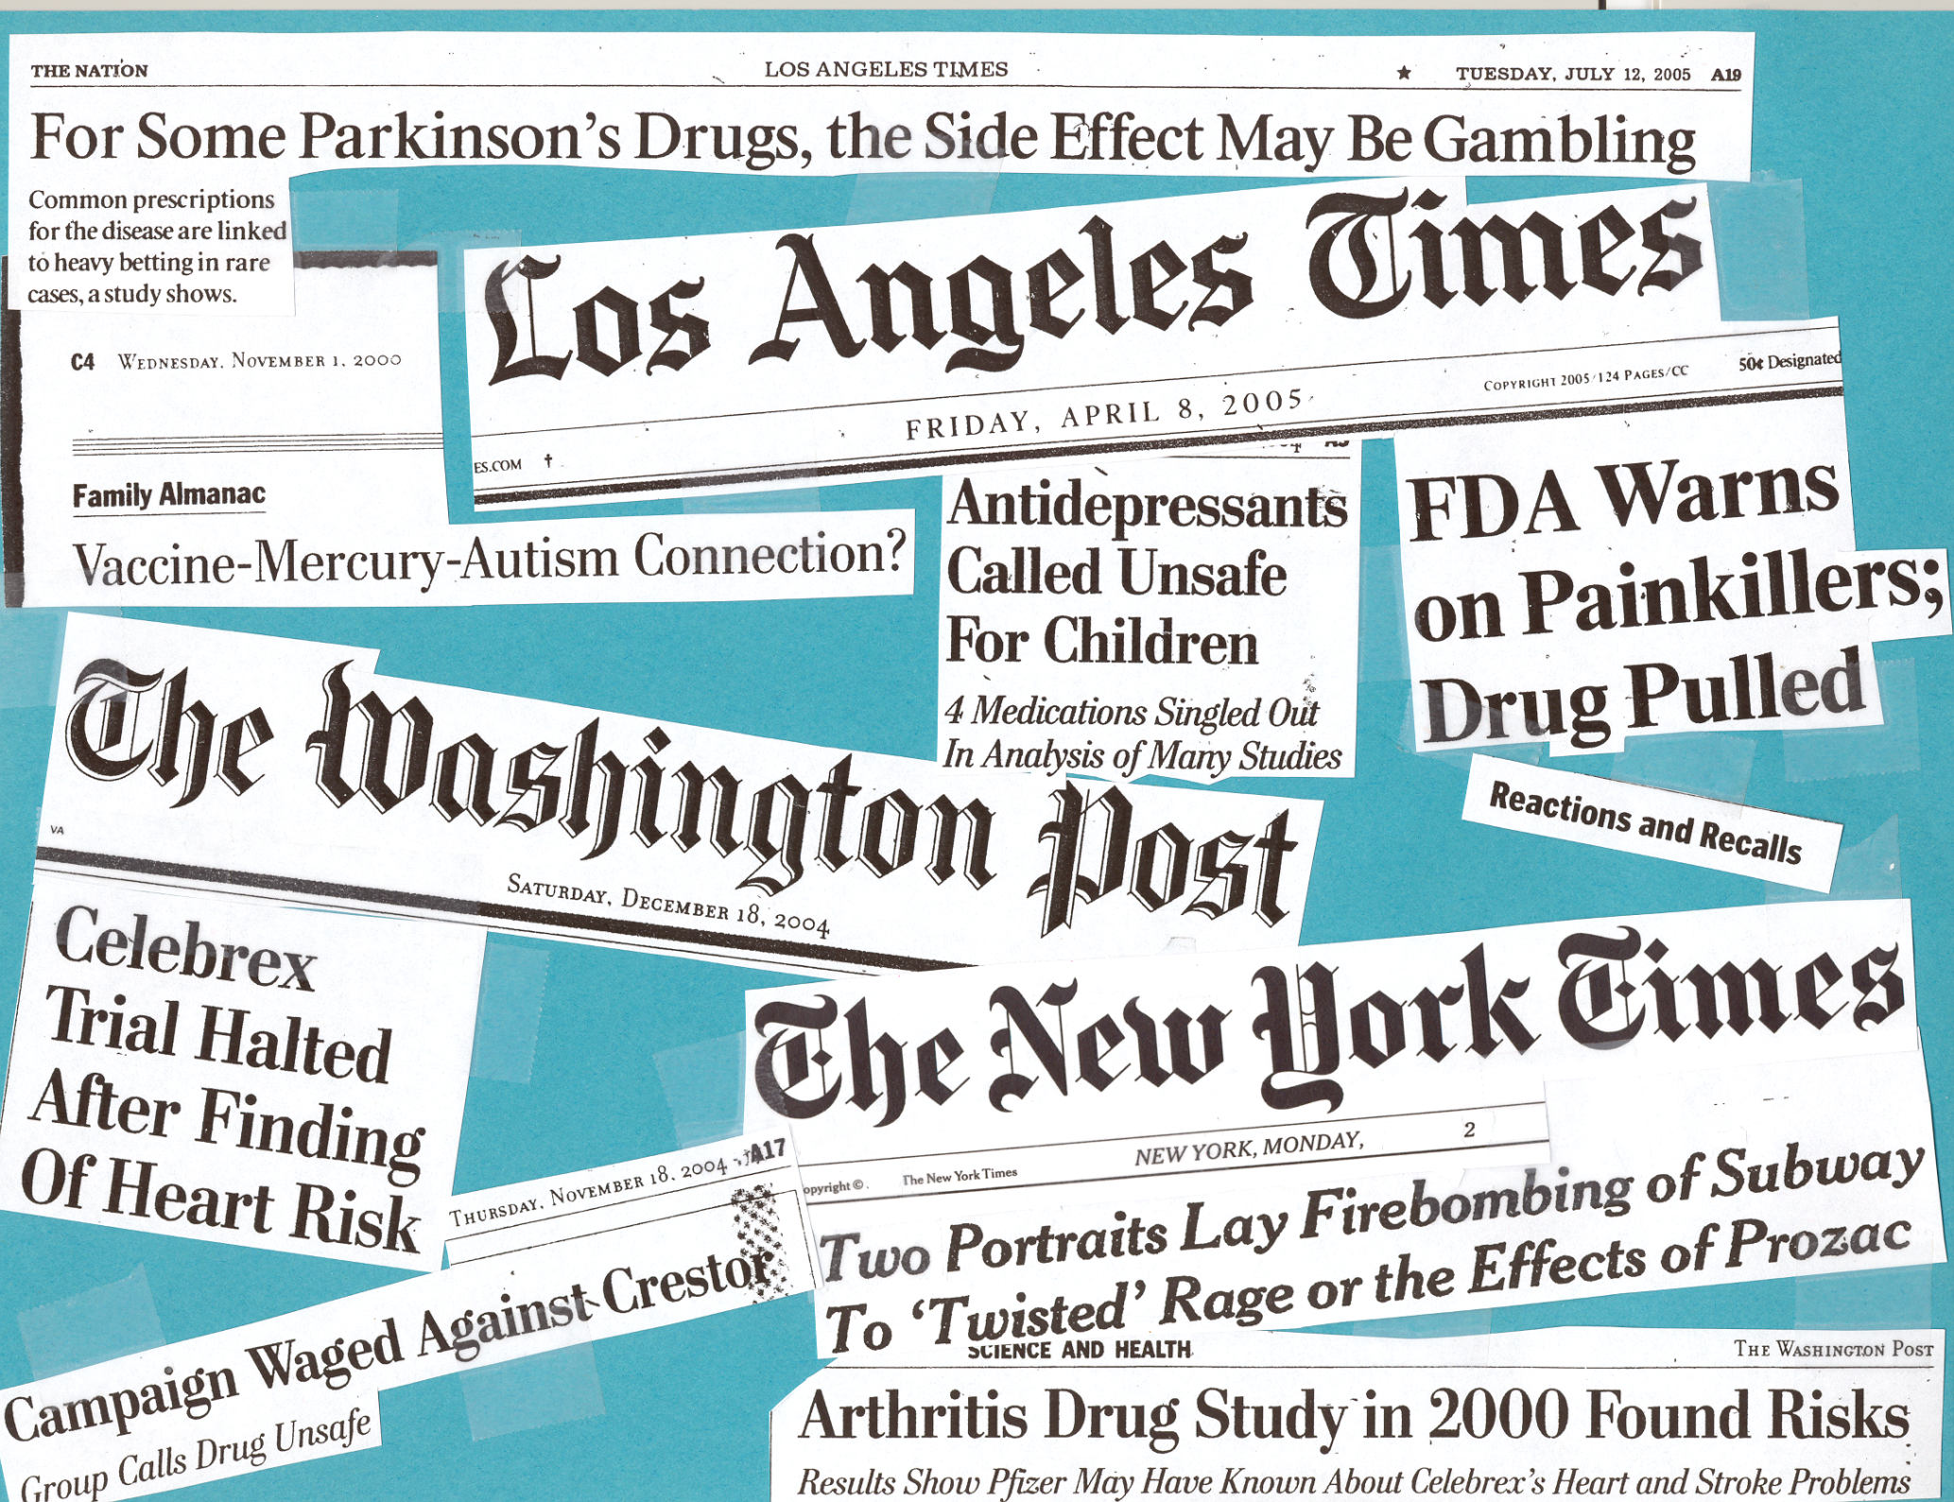

Slide 9
PERSONAL DECISIONS
Should I undergo surgery for relief of my back pain?
Should I vaccinate my children?
Should I start storing my leftovers in glass instead of plastic containers?
Do I need to use my cell phone less to reduce risk of brain cancer?
Should I keep taking my (antidepressant, painkiller, blood pressure drug, etc)?

Slide 10
PROOF IN MEDICINE
“Proof” in medicine is all about limiting the uncertainty surrounding our inferences from data
Classic approach: if A does not cause B, how likely would we have been to observe the results before us?
Completely analogous to flipping a coin to see if it is “fair;” if we flip a coin 10 times and get 8 heads, we wonder how likely it would be to get 8 or more heads with a fair coin

Slide 11
SMOKING AND LUNG CANCER
British Medical Journal, 1950, Doll and Hill
Smoking habits of hospitalized patients
Disease | Non-smokers | Smokers | Total
Males
lung cancer | 2 (0.3%) | 647 | 649
other disease | 27 (4.2%) | 622 | 649
Females
lung cancer | 19 (31.7%) | 41 | 60
other disease | 32 (53.3%) | 28 | 60

Slide 12
DID THIS PROVE SMOKING CAUSES LUNG CANCER?
Doll and Hill were pretty convinced
Many others were skeptical
Most men were smokers at that time
People didn’t want to believe that smoking was harmful
Some very eminent scientists at the time argued that there could have been other differences between the two sets of hospitalized patients that led to this apparent association
Maybe people who were predisposed to getting lung cancer were also predisposed to smoke

Slide 13
FUNDAMENTAL PROBLEM WITH OBSERVATIONAL DATA
Can have “association” without “causation”
There could be some other factor that is responsible for the apparent association
Example: the more churches there are in a town, the more bars there are
We call this phenomenon “confounding”

Slide 14
HORMONE REPLACEMENT AND HEART DISEASE
Many observational studies showed a lower rate of heart disease in postmenopausal women taking hormone replacement therapy
Biologically plausible finding
Example: Grodstein et al, 1996
Hormone use | Person-years | Heart disease cases | Relative risk
Never used | 304,744 | 431 | 1.0
Estrogen only | 82,620 | 47 | 0.45
Estrogen/progestin | 27,161 | 8 | 0.22

Slide 15
DID THESE STUDIES PROVE THAT HORMONE REPLACEMENT PREVENTS HEART DISEASE?
Many physicians believed they did
A very large proportion of postmenopausal women were prescribed this therapy
But there were skeptics who worried this could be a false association, caused by one or more confounding factors

Slide 16
AN ALTERNATIVE APPROACH
After many years of debate, the National Institutes of Health funded a large experiment—a randomized clinical trial—to study this question
Women were asked to have their treatment (hormones or placebo) decided by a coin flip
When treatment is assigned at random, any confounding factors (both known and unknown) will be equally distributed across treatment groups, so cannot influence the conclusions

Slide 17
NOT AN EASY STUDY TO DO
If most physicians believe hormone therapy will prevent bad disease, why would their patients agree to a 50% chance of getting a placebo?
Some were concerned the study was unethical because half the women would not get a treatment they believed was beneficial

Slide 18
WHAT HAPPENED?
The clinical trial entered over 68,000 women from 1993 through 1998, and followed their health status
In 2002 the main results were announced
The women who received hormone replacement therapy had MORE heart disease than women who received placebo
The observational studies were wrong

Slide 19
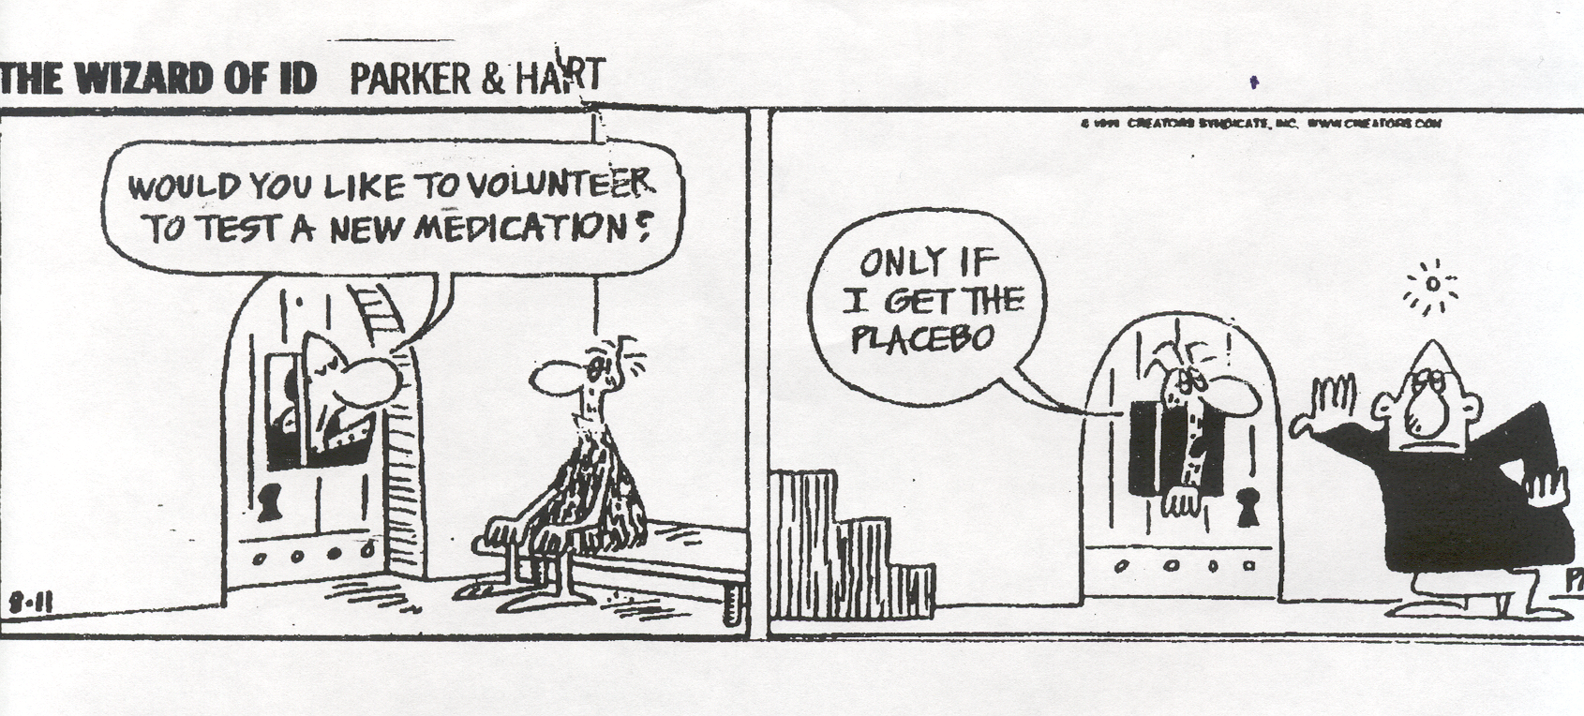

Slide 20
WHY WERE THE RESULTS DIFFERENT?
Best guess: despite efforts in the observational studies to account for differences between women who did and did not take hormones, there was probably some remaining “healthy subject” bias
Women who were prescribed hormones were somewhat healthier than women who were not
This may have outweighed the harm caused by the hormone therapy

Slide 21
SMOKING VS HORMONES
Important difference between these cases
One question could be studied in a randomized trial; the other could not
Randomized trials are the best* way we have to “prove” something in medicine but clearly many important questions cannot be studied in this way
*”best” is not perfect; we may have multiple randomized trials with conflicting results!

Slide 22
PROOF AND THE RANDOMIZED CLINICAL TRIAL
Give half of the subjects treatment A and half treatment B
Observe the number of successes for A and B
Calculate how likely these numbers would be if A and B truly had the same chance of producing a success
Treatment | A | B | Total
Success | 15 (50%) | 21 (70%) | 36
Failure | 15 | 9 | 24
Total | 30 | 30 | 60

Slide 23
PROOF AND THE RANDOMIZED CLINICAL TRIAL
Expected outcomes (no treatment effect)
Observed outcomes
Treatment | A | B | Total
Success | 18 | 18 | 36
Failure | 12 | 12 | 24
Total | 30 | 30 | 60
Treatment | A | B | Total
Success | 15 (50%) | 21 (70%) | 36
Failure | 15 | 9 | 24
Total | 30 | 30 | 60

Slide 24
PROOF AND THE RANDOMIZED CLINICAL TRIAL
A biostatistician will help design a trial so that the results will be considered “proof”
The trial will have to be big enough so that, if you observe a difference at least as large as you think you will, you will be able to dismiss the possibility that the difference is just due to chance
We make sure that the amount of uncertainty about the result is small

Slide 25
WHAT WE CAN STUDY IN A RANDOMIZED TRIAL
Effectiveness and safety of medical treatments
Whether one treatment is preferable to another
Approaches to disease prevention (harder)
Smoking cessation programs
Diets
Exercise programs

Slide 26
WHAT WE CAN’T STUDY IN A RANDOMIZED TRIAL
Effects of environmental exposures

Slide 27
WHAT WE CAN’T STUDY IN A RANDOMIZED TRIAL
Effects of environmental exposures
Effects of inherent individual characteristics
Implications of genetic characteristics

Slide 28
WHAT WE CAN’T STUDY IN A RANDOMIZED TRIAL
Effects of environmental exposures
Effects of inherent individual characteristics
Implications of genetic characteristics
Effects of “lifestyle choices”
Amount of alcohol consumed
Level and /or type of sexual activity

Slide 29
WHAT WE CAN’T STUDY IN A RANDOMIZED TRIAL
Effects of environmental exposures
Effects of inherent individual characteristics
Implications of genetic characteristics
Effects of “lifestyle choices”
Amount of alcohol consumed
Level and /or type of sexual activity
Treatments for extremely rare conditions

Slide 30
WHAT WE CAN’T STUDY IN A RANDOMIZED TRIAL
Effects of environmental exposures
Effects of inherent individual characteristics
Implications of genetic characteristics
Effects of “lifestyle choices”
Amount of alcohol consumed
Level and /or type of sexual activity
Treatments for extremely rare conditions
Potential harms of a treatment with known important benefits

Slide 31
CONFOUNDING FACTORS
We attempt to study such questions using observational data but have to contend with confounding
Alcohol consumption shows an association with lung cancer, but heavy drinkers are more likely to be smokers than occasional or non-drinkers
Environmental exposures can be confounded with socioeconomic status, which affects where people live and work, what they eat, etc.
Many biostatisticians focus their research on methods to reduce the effect of confounding factors on the association

Slide 32
BIG ISSUE: VACCINE SAFETY
Virtually every child receives multiple vaccines at multiple times, starting at or soon after birth
Just about every bad thing that happens to a baby or a child follows the initiation of vaccinations
It is understandable that parents of a child diagnosed with a serious illness or condition shortly after one or more vaccinations would wonder if the vaccines caused the problem

Slide 33
VACCINES AND AUTISM
The rate of autism diagnosis has increased markedly
The number of vaccines given to children has increased markedly
Is there a connection? Can we prove it one way or the other?
Could we do a randomized trial to see if vaccinated children were less likely to become autistic?

Slide 34
THE DIFFICULTY
Because of the clinical trials that have been done we know that vaccines are very effective at preventing serious diseases
It would be unethical to conduct a study that left some children unprotected
Since nearly all children are vaccinated, and those who are not are different in important ways from those who are, even observational studies are difficult to do

Slide 35
THE DIFFICULTY
Because of the clinical trials that have been done we know that vaccines are very effective at preventing serious diseases
It would be unethical to conduct a study that left some children unprotected
Since nearly all children are vaccinated, and those who are not are different in important ways from those who are, even observational studies are difficult to do
(Note: many studies assessing specific vaccines have been done and have not shown any association of these vaccines with autism)

Slide 36
PROVING A NEGATIVE
Often we are interested in demonstrating that there is NO association between an exposure and an outcome
We might want to show that a lower dose of a drug is just as effective as a higher dose
We might want to show that a new treatment that might be safer, or more convenient to take, or cheaper, is just as good as the standard treatment
We might want to show (as in the vaccine example) that a particular treatment, or exposure, does not have an adverse effect.

Slide 37
PROVING A NEGATIVE
Even when a clinical trial is possible, it is more complicated than when we want to show that an effect is GREATER THAN zero
Consider the example of lower vs higher dose
We don’t want to use the lower dose if it’s worse
We don’t think that the lower dose can be better
We know that the difference can’t be exactly zero

Slide 38
SO WHAT DO WE DO?
We recognize that “no worse” has to be stretched to mean “no more than a LITTLE BIT worse”
We design our study so that the probability that the lower dose will appear more than a little bit worse is very small, if in fact it is truly NO worse
If we think the standard dose will be successful 75% of the time, we might design our study so that, if the low dose is as good as the standard dose, it won’t appear more than 5% worse

Slide 39
MORE UNCERTAINTY
If a treatment is successful 75% of the time in one study, how likely is it to be successful at least 75% of the time in another study?
Easy to calculate, if the people in the second study are just like the people in the first study…
Or, if we can assume that even if people in the second study are NOT like people in the first study, the differences won’t affect the chance that the treatment will be successful…
Or, even if the differences will affect the chance of success, we can use a statistical model that will adjust for these differences (if we know what they are)

Slide 40
ANOTHER COMPONENT OF PROOF IN MEDICINE
Biology is important
In some cases, what we know about the biology makes all the difference
Do we need a randomized trial to prove that a particular food or drug can cause a serious allergic reaction?
Could we prove that homeopathy “works” by doing a randomized trial?

Slide 41
HOMEOPATHY
Homeopathy is an “alternative” approach to medical treatment that is based on the concept that small doses of a substance that causes disease symptoms will effectively treat that disease
Practitioners take such a substance and dilute it down so that in many cases it is impossible to find even one molecule of the substance in the dose given to a patient
The dilutant is supposed to retain the memory of the original substance

Slide 42
HOMEOPATHY
Most medical practitioners dismiss the concept of homeopathy on scientific grounds
If presented with a randomized clinical trial that yielded a positive result they would not change their belief
They would assume the trial had not been conducted properly
Healthier patients had been given the homeopathy
Measurement of the outcome had been influenced by knowledge of who was taking which treatment
Fraud

Slide 43
MANY OTHER ASPECTS TO “PROOF”
There are many ways to make results look stronger than they should
If your study shows that your drug doesn’t work, find a subset of the study population in which it DOES appear to work (surprisingly easy)
If you don’t find the effect you were looking for, look for some other effect—if you look hard enough you’ll find one (data dredging)
When we consider study results we want to make sure we’re not being had

Slide 44
ALL IS NOT CONFUSION
There are many things we do know
Vaccines prevent disease
Antibiotics cure infections
Drugs and radiation can shrink tumors
Epinephrine can diminish allergic responses
Antiviral drugs can control HIV replication and prevent transmission of HIV from mother to child
Exposure to lead is bad for developing brains
Chronic exposure to asbestos promotes mesothelioma
Certain genetic characteristics predispose to breast cancer

Slide 45
A leading medical researcher once called statisticians the “terrorists of medical research”
Clinical investigators don’t always appreciate being told that their findings could be due to chance, or that the analysis they want to do is invalid
Our job is to avoid pitfalls, and develop improved methods of design and analysis
There is always some residual uncertainty

Slide 46
TO SUM UP
Proof in medical research is subjective
Even widely accepted beliefs are questioned by some
HIV is the cause of AIDS
The best we can do is to improve our understanding of the underlying biology, and design and conduct studies that minimize the probability we will draw erroneous conclusions
We have to be open to the possibility that someone will “disprove” what we have just “proven”

