Slide 1

Road to Retirement
Jerry Porter
May 12, 2011

Slide 2
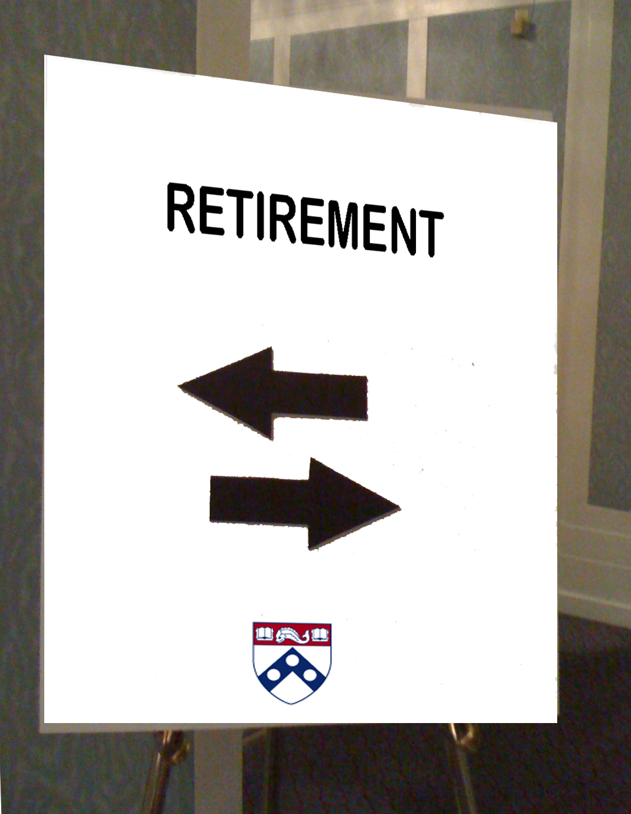
Roads to Retirement

Slide 3



Roads to Retirements
35 + states
UK Switzerland Sweden Greece Germany France Chile Canada

Slide 4


Slide 5
Why did I retire?

Slide 6

It’s socially irresponsible not to retire.

Slide 7
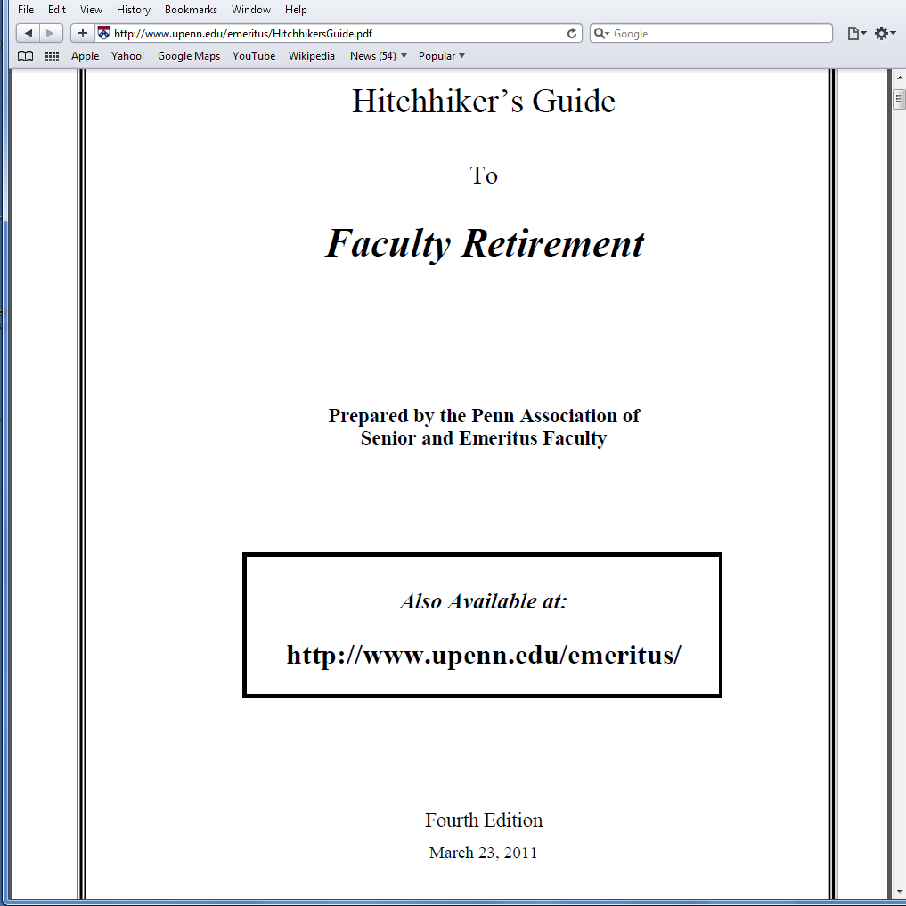
FIAP is a very good benefit.

Slide 8
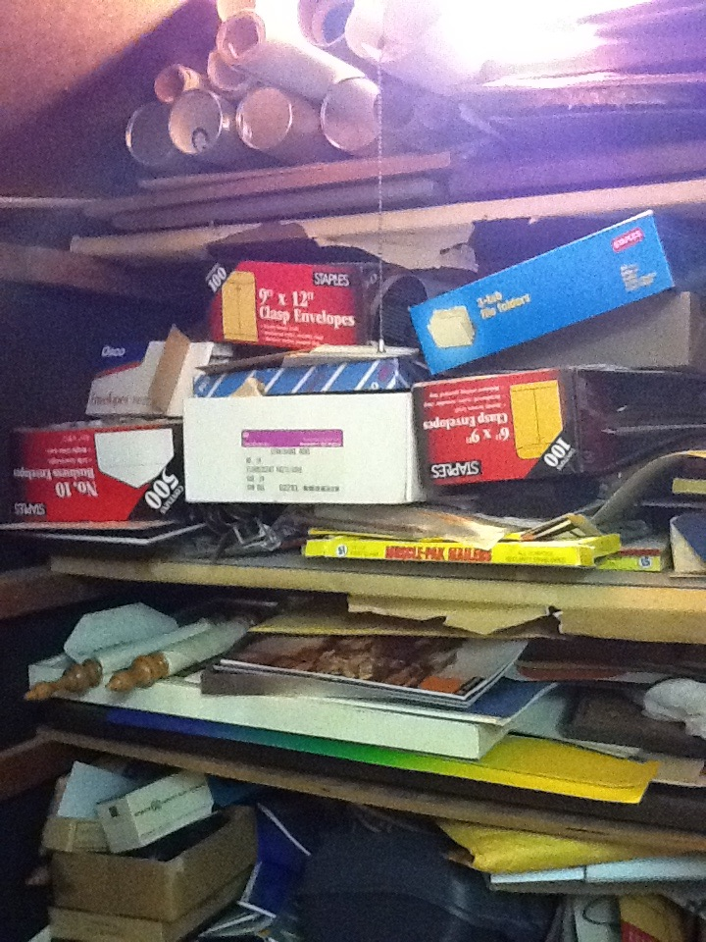
I didn’t retire to clean closets.

Slide 9
More to Life than just Mathematics

Slide 10

Places to go, teaching takes time.

Slide 11
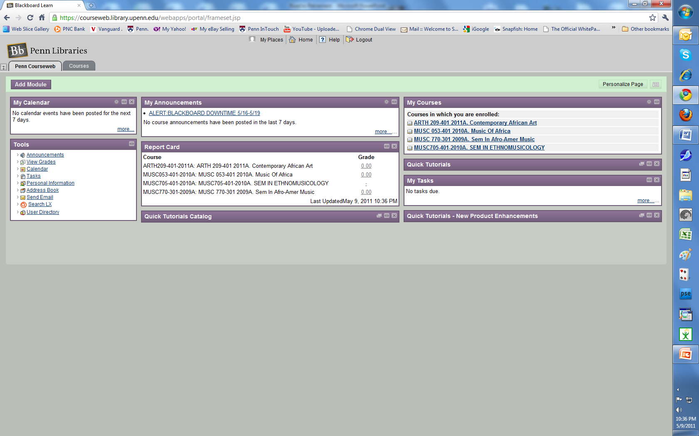
Lots to Learn, So Little Time

Slide 12
MAJOR DIFFERENCES
No Teaching,
No Meetings,
No Pay

Slide 13
Retired from Teaching
Still at Penn.

Slide 14
My six word memoirs about Penn

Slide 15
Good Colleagues
Good Students
Great Job

Slide 16
Many careers
One Employer
Thanks, Penn

Slide 17
Came to Penn
Enjoyed the Trip

