Slide 1
Application of Topology in Robotics: Collisions
Ekaterina Skorniakova
Mentor: Travis Leadbetter
University of Pennsylvania
Directed Reading Program, April 2022

Slide 2
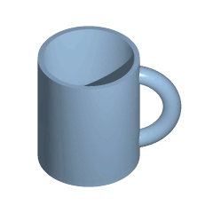
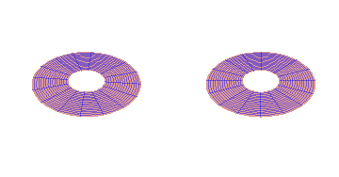
What is Topology?
τόπος, 'position, location'
Credit: Wikipedia
: study of geometric spaces that are preserved under continuous deformations

Slide 3
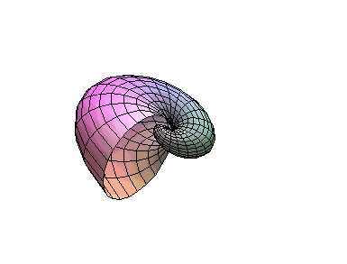
Rules of the game:
Allowed:
Continuous transformations: twisting, stretching, shrinking
Prohibited:
Discontinuous transformations: cutting, tearing, puncturing,
Forget concepts such as length, size, magnitude; focus on RELATIVE positions
Notes:
How is this abstract concept tied to something concrete as robotics: moving solid parts powered and controlled by electrical circuits?

Slide 4
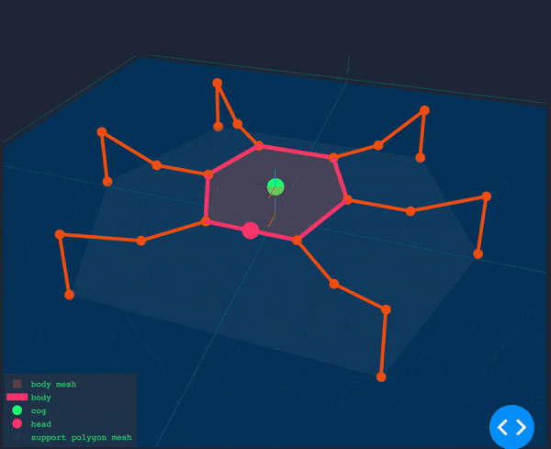
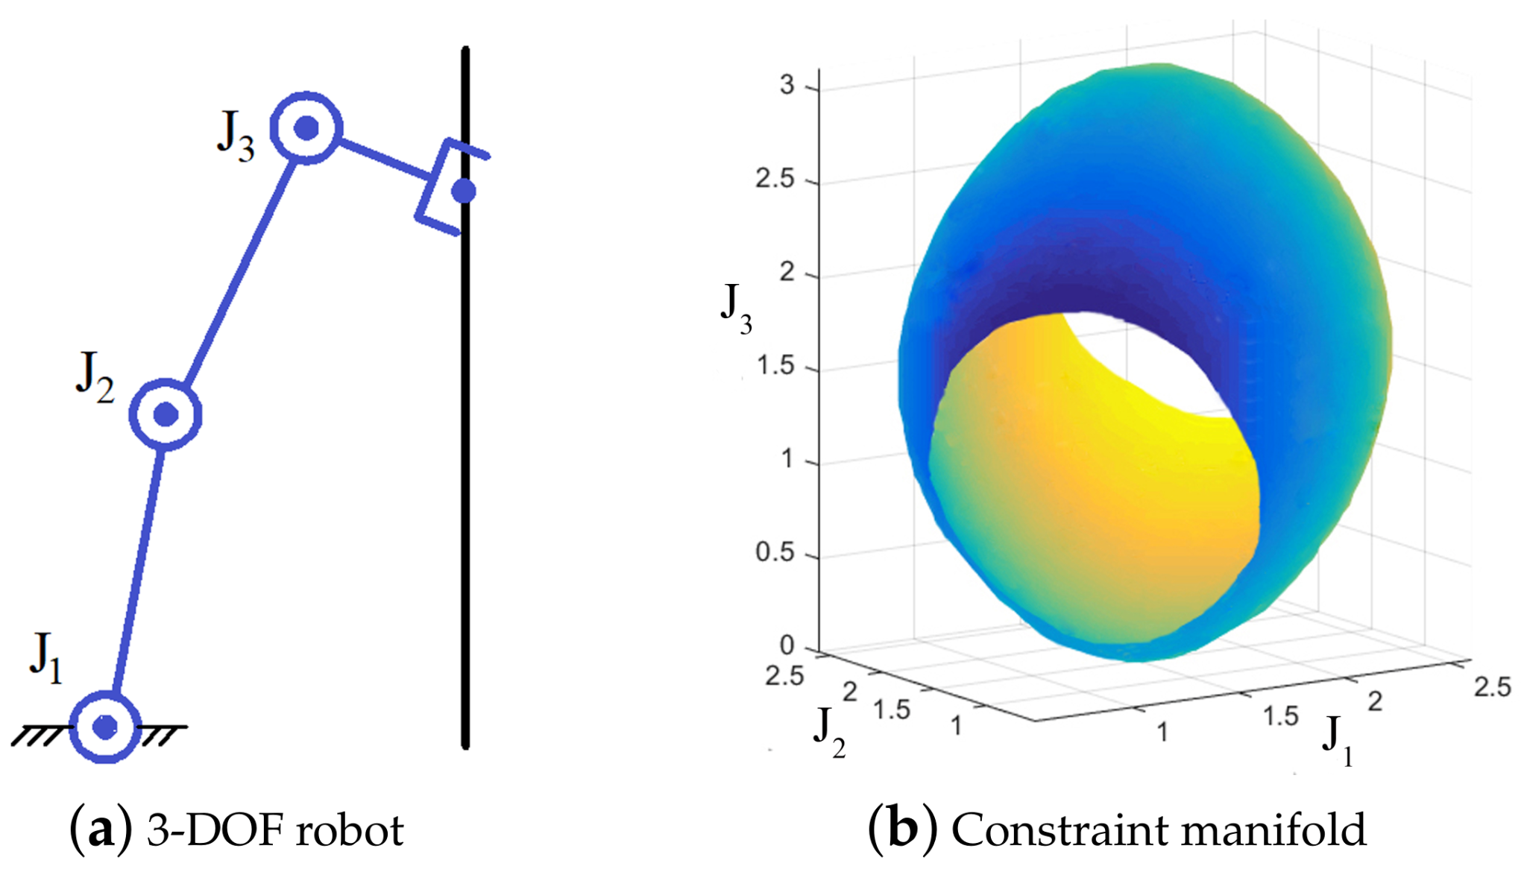
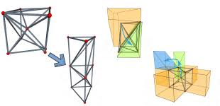
Intersections between Topology and Robotics
Configuration Spaces
Motion Planning
Collision Avoidance

Slide 5
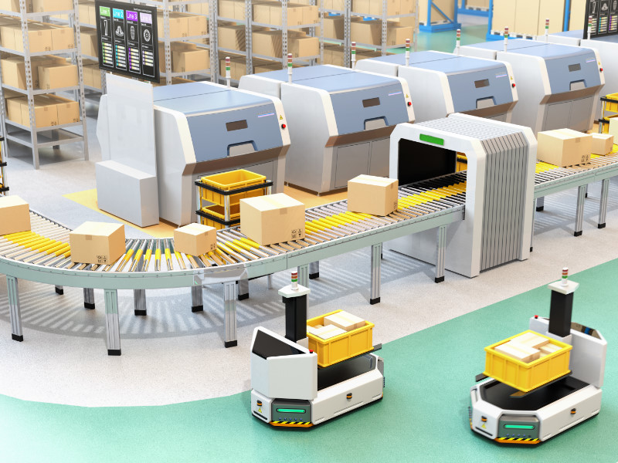
Question:
How can we use topology
to determine whether robots will collide?
Notes:
Must define some terms

Slide 6
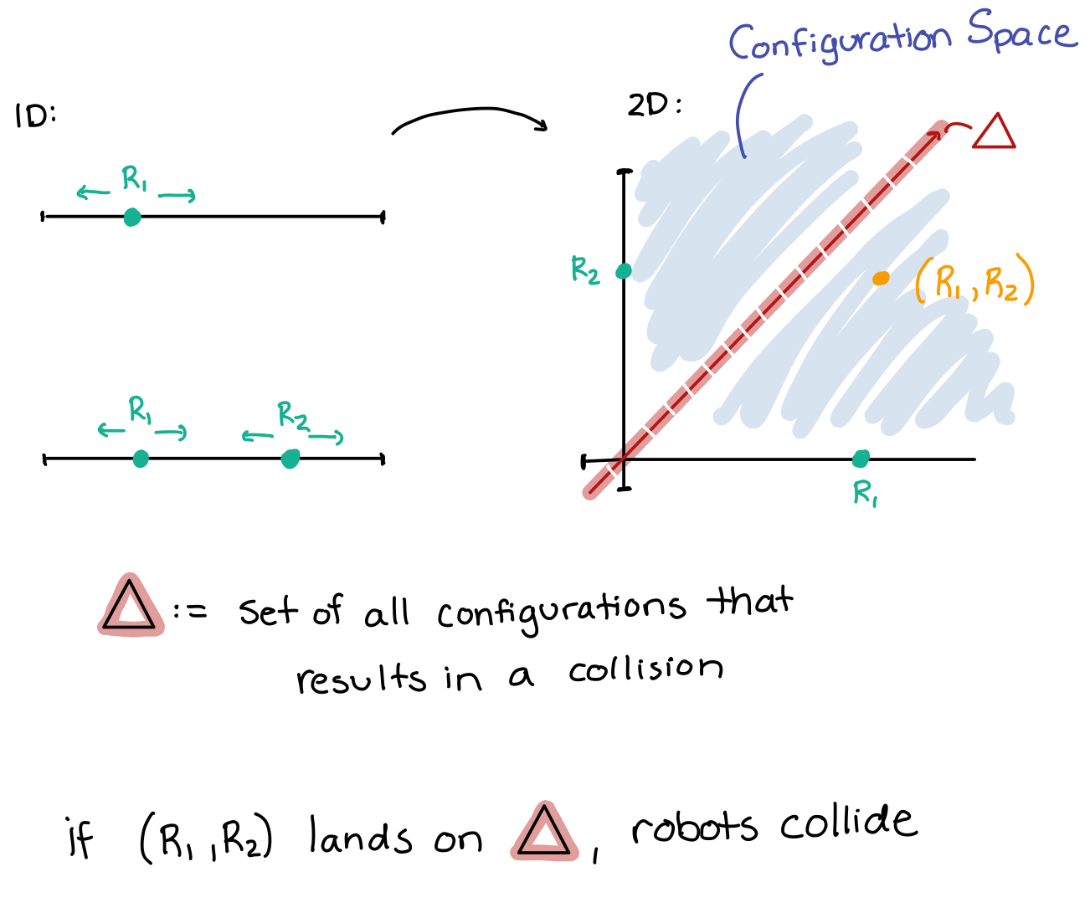
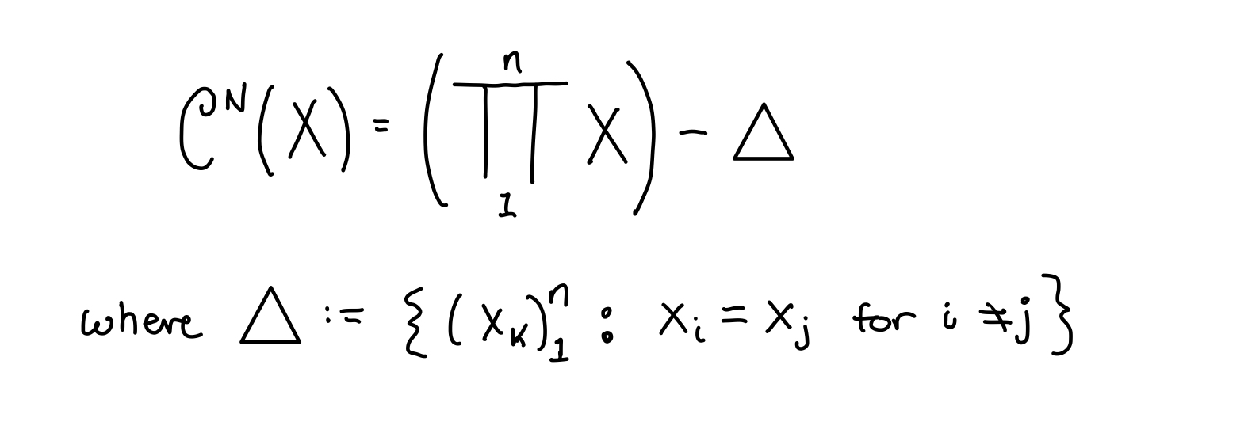
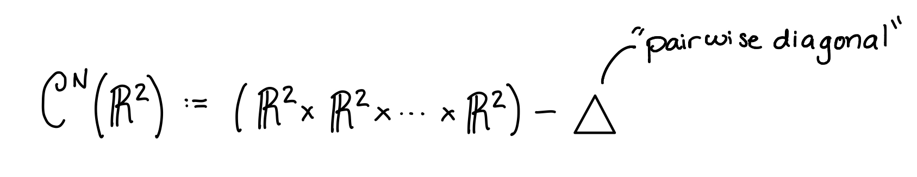
Configuration Space
Mathematician’s definition: n-fold product of the space, X (where a single robot lives), set minus the set delta; delta is the set of overlapping points
In X:
In 2D:
Engineer’s definition: configuration of n robots s.t. none of them collide
Notes:
The configuration space of motion planning

Slide 7
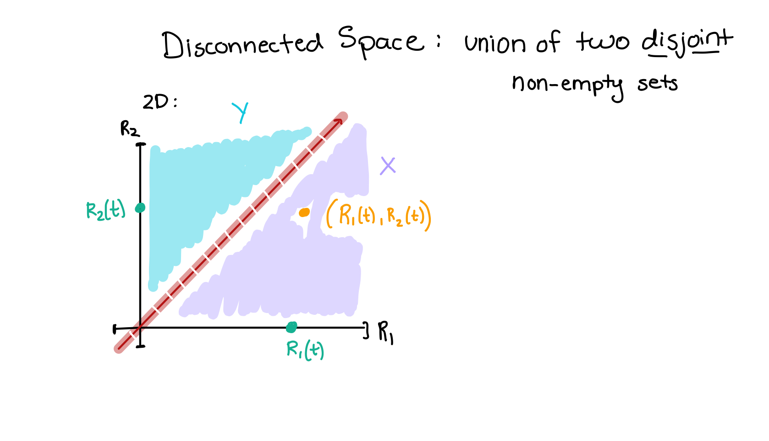
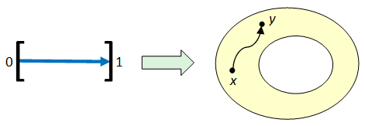
Connectedness : continuity in topological space
To describe the path/trajectory of the robots, need the notion of time
Notes:
Topological property

Slide 8
Defining the Joint Path of the Robots

Slide 9
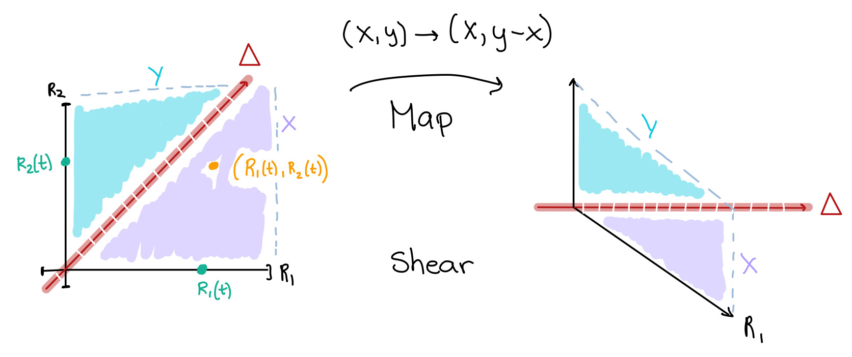
Homeomorphisms preserve topological properties
Homeomorphisms: continuous bijections with continuous inverses
Notes:
Homeomorphism is a map

Slide 10
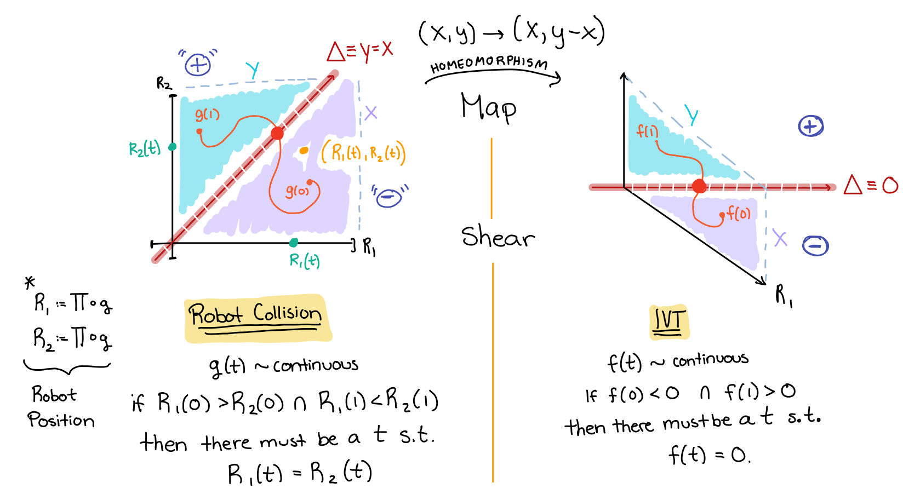
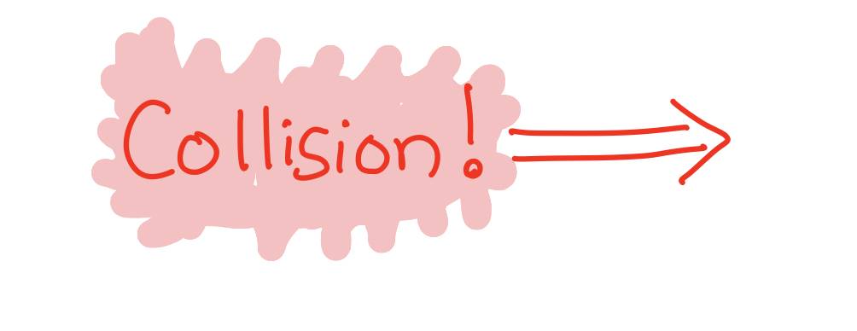
Intermediate Value Theorem (?!?)
COLLISION

Slide 11
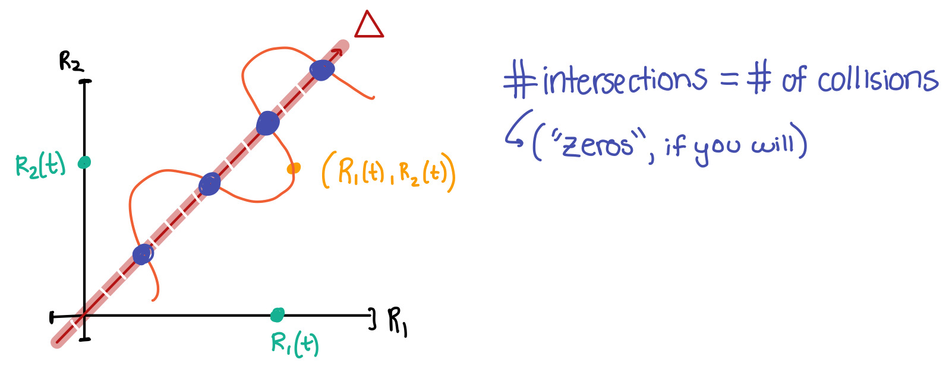
Collision Detected!

Slide 12
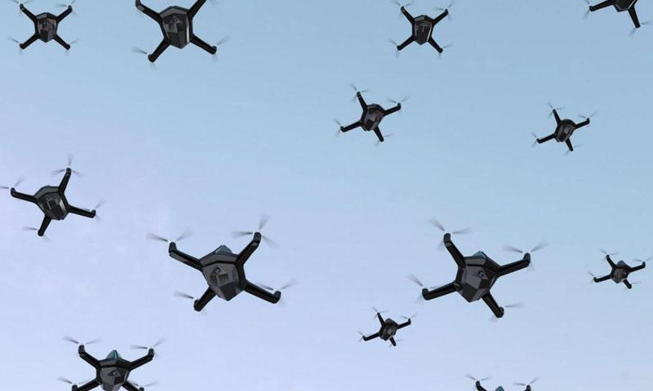
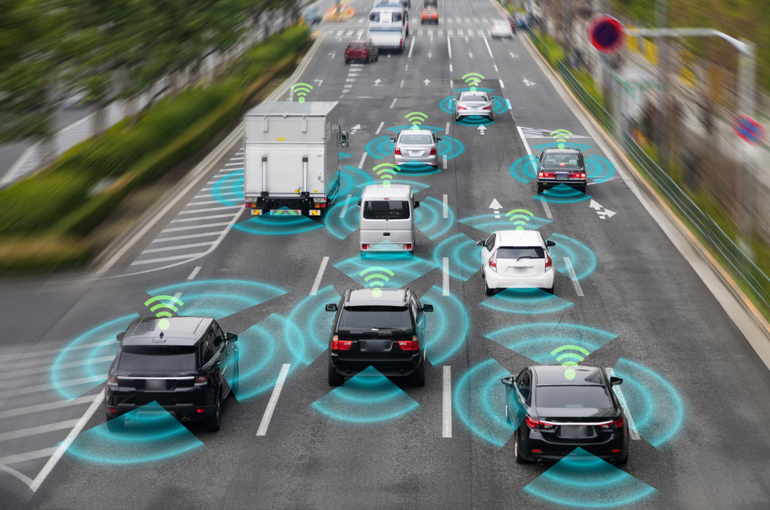
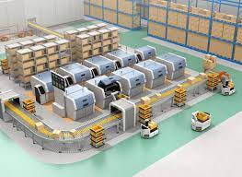
Applications

