Slide 1
Parametric Time Series Analysis
Sam Rosenberg
University of Pennsylvania
DRP Presentations
April 30th, 2020

Slide 2
What is a time series?

Slide 3
What is a time series?
A collection of random variables indexed over time

Slide 4
What is a time series?
A collection of random variables indexed over time
i.e. a stochastic or nondeterministic process

Slide 5
What is a time series?
A collection of random variables indexed over time
i.e. a stochastic or nondeterministic process
Each time index has its own random variable

Slide 6
What is a time series?
A collection of random variables indexed over time
i.e. a stochastic or nondeterministic process
Each time index has its own random variable

Slide 7
Where do time series occur?

Slide 8
Where do time series occur?

Slide 9
Where do time series occur?

Slide 10
Where do time series occur?

Slide 11
Where do time series occur?

Slide 12
What does it mean to analyze a time series?

Slide 13
Why is analysis important?

Slide 14
What are some types of time series analysis?

Slide 15
What are some types of time series analysis?
Parametric

Slide 16
What are some types of time series analysis?
Parametric
Assume data fits a model

Slide 17
What are some types of time series analysis?
Parametric
Assume data fits a model
Find model parameters that best fit data

Slide 18
What are some types of time series analysis?
Parametric
Assume data fits a model
Find model parameters that best fit data
Nonparametric

Slide 19
What are some types of time series analysis?
Parametric
Assume data fits a model
Find model parameters that best fit data
Nonparametric
Use intrinsic properties of time series

Slide 20
What are some types of time series analysis?
Parametric
Assume data fits a model
Find model parameters that best fit data
Nonparametric
Use intrinsic properties of time series
Do not fit model to data

Slide 21
What are some types of time series analysis?

Slide 22
What are some types of time series analysis?
Time domain
Frequency domain

Slide 23
What are some types of time series analysis?
Time domain
Frequency domain

Slide 24
What are some types of time series analysis?
Time domain
Frequency domain

Slide 25
What quantities do we use for analysis?

Slide 26
What quantities do we use for analysis?

Slide 27
What quantities do we use for analysis?
Mean

Slide 28
What quantities do we use for analysis?
Mean
Average value

Slide 29
What quantities do we use for analysis?
Mean
Average value
Single random variable

Slide 30
What quantities do we use for analysis?
Mean
Average value
Single random variable

Slide 31
What quantities do we use for analysis?
Mean
Average value
Single random variable

Slide 32
What quantities do we use for analysis?
Mean
Variance
Average value
Single random variable

Slide 33
What quantities do we use for analysis?
Mean
Variance
Average value
Deviance from mean
Single random variable

Slide 34
What quantities do we use for analysis?
Mean
Variance
Average value
Deviance from mean
Single random variable
Single random variable

Slide 35
What quantities do we use for analysis?
Mean
Variance
Average value
Deviance from mean
Single random variable
Single random variable

Slide 36
What quantities do we use for analysis?
Mean
Variance
Average value
Deviance from mean
Single random variable
Single random variable

Slide 37
What quantities do we use for analysis?
Mean
Variance
Autocovariance
Average value
Deviance from mean
Single random variable
Single random variable

Slide 38
What quantities do we use for analysis?
Mean
Variance
Autocovariance
Average value
Deviance from mean
Linear dependence
Single random variable
Single random variable

Slide 39
What quantities do we use for analysis?
Mean
Variance
Autocovariance
Average value
Deviance from mean
Linear dependence
Single random variable
Single random variable
Two random variables

Slide 40
What quantities do we use for analysis?
Mean
Variance
Autocovariance
Average value
Deviance from mean
Linear dependence
Single random variable
Single random variable
Two random variables

Slide 41
What quantities do we use for analysis?
Mean
Variance
Autocovariance
Average value
Deviance from mean
Linear dependence
Single random variable
Single random variable
Two random variables

Slide 42
What quantities do we use for analysis?
Mean
Variance
Autocovariance
Autocorrelation
Average value
Deviance from mean
Linear dependence
Single random variable
Single random variable
Two random variables

Slide 43
What quantities do we use for analysis?
Mean
Variance
Autocovariance
Autocorrelation
Average value
Deviance from mean
Linear dependence
Normalized dependence
Single random variable
Single random variable
Two random variables

Slide 44
What quantities do we use for analysis?
Mean
Variance
Autocovariance
Autocorrelation
Average value
Deviance from mean
Linear dependence
Normalized dependence
Single random variable
Single random variable
Two random variables
Two random variables

Slide 45
What quantities do we use for analysis?
Mean
Variance
Autocovariance
Autocorrelation
Average value
Deviance from mean
Linear dependence
Normalized dependence
Single random variable
Single random variable
Two random variables
Two random variables

Slide 46
What are some basic models?

Slide 47
What are some basic models?
White noise

Slide 48
What are some basic models?
White noise
Purely random and uncorrelated

Slide 49
What are some basic models?
White noise
Purely random and uncorrelated

Slide 50
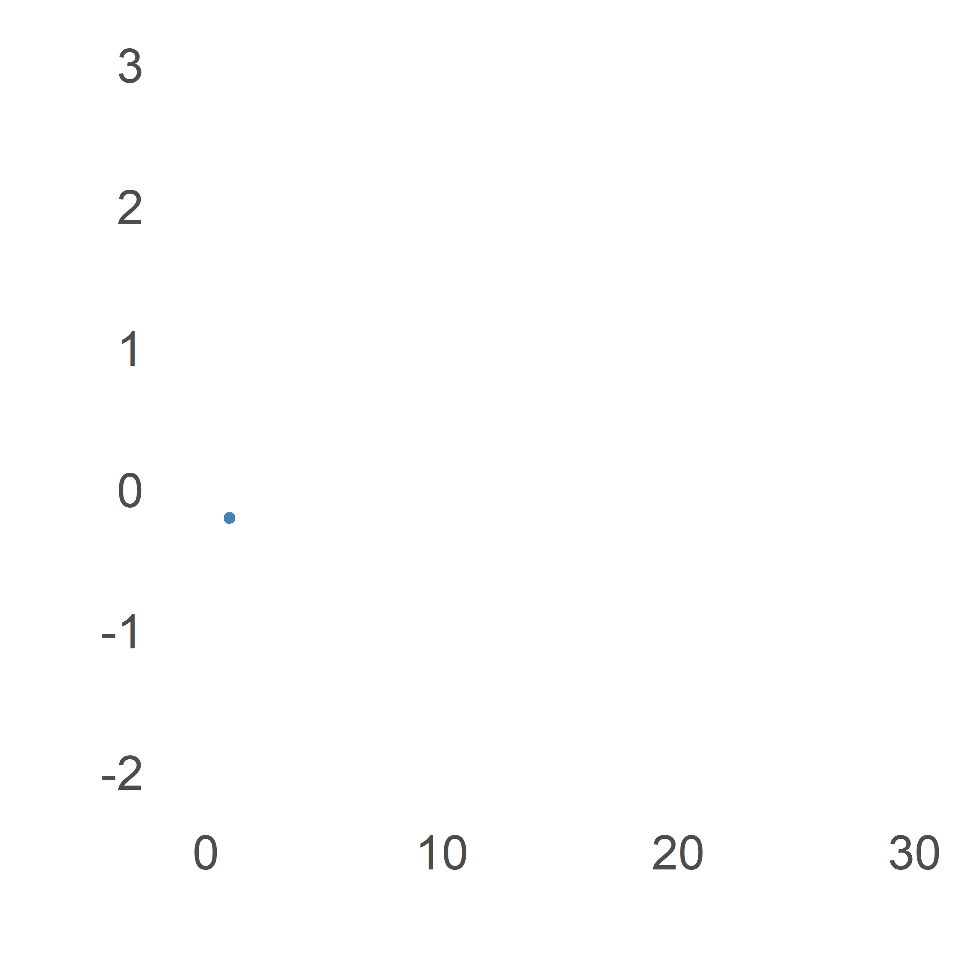
What are some basic models?
White noise
Purely random and uncorrelated

Slide 51
What are some basic models?

Slide 52
What are some basic models?
Random walk

Slide 53
What are some basic models?
Random walk
Each value depends on last value, plus a random amount

Slide 54
What are some basic models?
Random walk
Each value depends on last value, plus a random amount

Slide 55
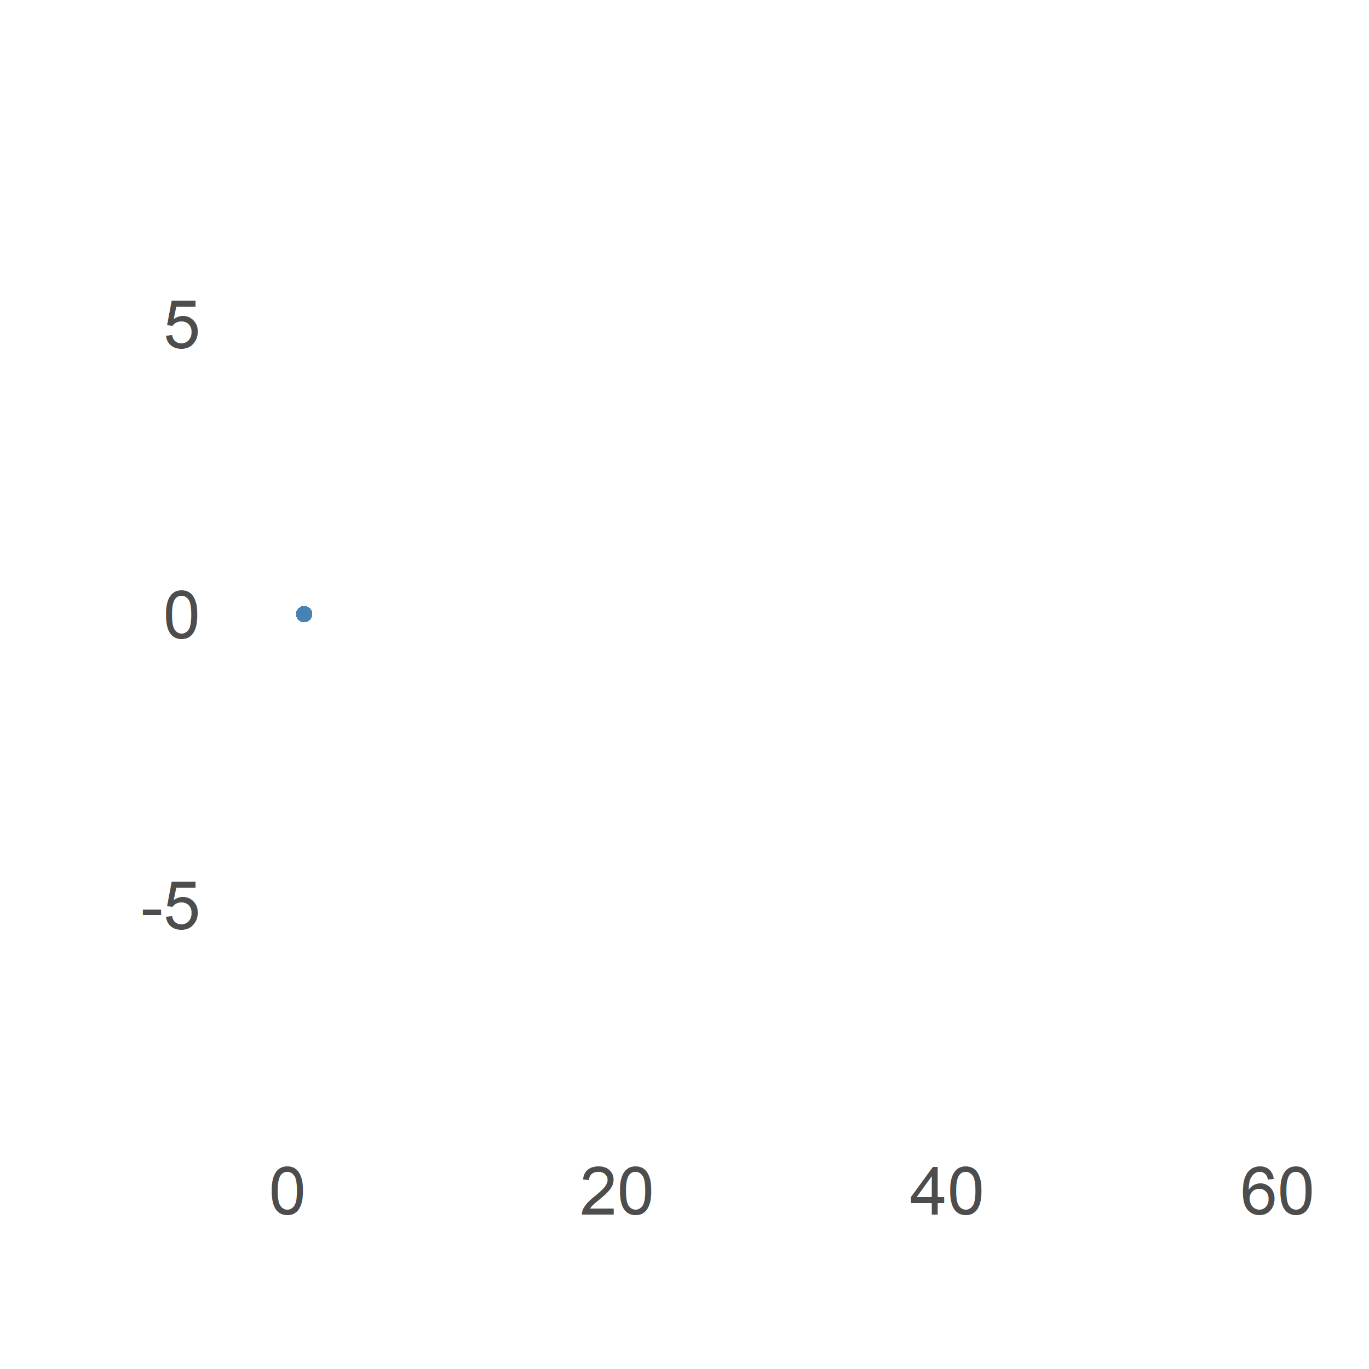
What are some basic models?
Random walk
Each value depends on last value, plus a random amount

Slide 56
What are some basic models?

Slide 57
What are some basic models?
ARMA(p,q)

Slide 58
What are some basic models?
ARMA(p,q)
Combines ideas of white noise and random walk

Slide 59
What are some basic models?
ARMA(p,q)
Combines ideas of white noise and random walk

Slide 60
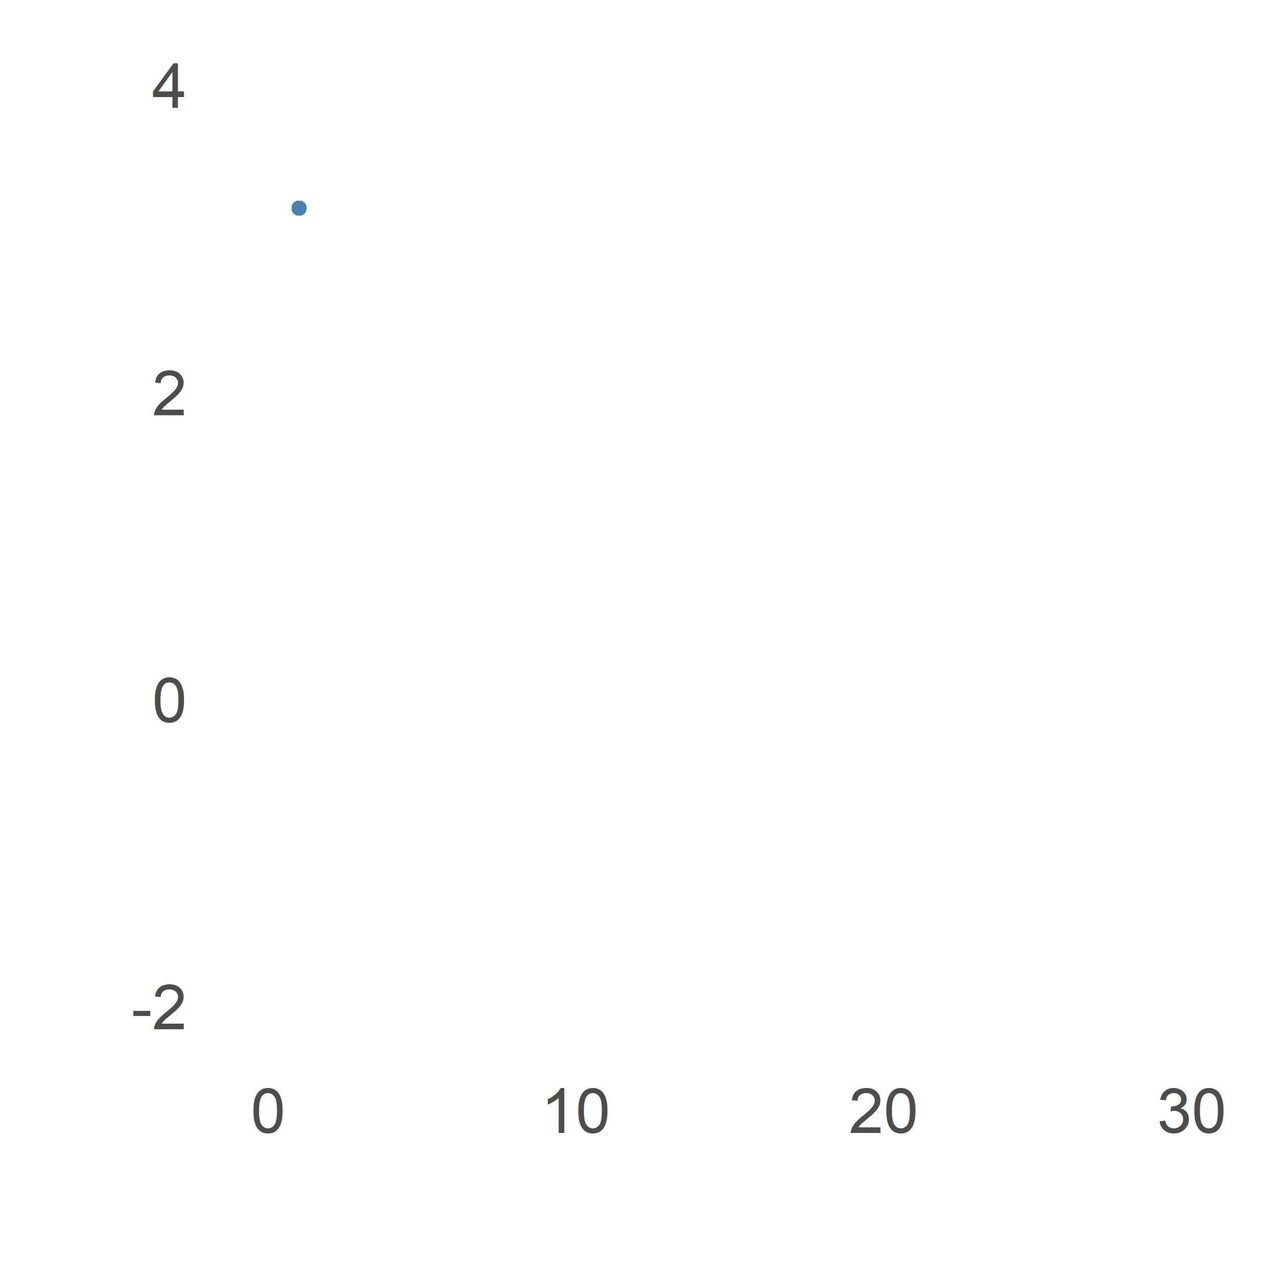
What are some basic models?
ARMA(p,q)
Combines ideas of white noise and random walk

Slide 61
What conditions do we need for analysis?

Slide 62
What conditions do we need for analysis?
Issues with real data

Slide 63
What conditions do we need for analysis?
Issues with real data
How do we fix this?

Slide 64
What conditions do we need for analysis?
Issues with real data
How do we fix this?
Strictly stationary series

Slide 65
What conditions do we need for analysis?
Issues with real data
How do we fix this?
Strictly stationary series
Any subset of series identical when time-shifted

Slide 66
What conditions do we need for analysis?
Issues with real data
How do we fix this?
Strictly stationary series
Any subset of series identical when time-shifted
This fixes our problem!

Slide 67
What conditions do we need for analysis?
Issues with real data
How do we fix this?
Strictly stationary series
Any subset of series identical when time-shifted
This fixes our problem!
Often too strong for real data

Slide 68
What conditions do we need for analysis?
Issues with real data
How do we fix this?
Strictly stationary series
Any subset of series identical when time-shifted
This fixes our problem!
Often too strong for real data
Weakly stationary instead

Slide 69
What conditions do we need for analysis?
Issues with real data
How do we fix this?
Strictly stationary series
Any subset of series identical when time-shifted
This fixes our problem!
Often too strong for real data
Weakly stationary instead
Mean independent of time, cov($x_{t},x_{t+h}$) dependent only on |h|

Slide 70
What conditions do we need for analysis?
Issues with real data
How do we fix this?
Strictly stationary series
Any subset of series identical when time-shifted
This fixes our problem!
Often too strong for real data
Weakly stationary instead
Mean independent of time, cov($x_{t},x_{t+h}$) dependent only on |h|
Main assumption for time series analysis

Slide 71
Parametric Time Series Analysis in Context

Slide 72
Parametric Time Series Analysis in Context
Pre-Processing

Slide 73
Parametric Time Series Analysis in Context
Pre-Processing
Small portion of all parametric models

Slide 74
Parametric Time Series Analysis in Context
Pre-Processing
Small portion of all parametric models
E.g. GARCH model used in finance

Slide 75
Parametric Time Series Analysis in Context
Pre-Processing
Small portion of all parametric models
E.g. GARCH model used in finance
Primarily discussed time domain

Slide 76
Parametric Time Series Analysis in Context
Pre-Processing
Small portion of all parametric models
E.g. GARCH model used in finance
Primarily discussed time domain
Nonparametric analysis drastically different

Slide 77
Thank you for listening!
Data taken from NOAA Global Historical Climatology Network (GHCN), Our World in Data, and Yahoo Finance

