Slide 1
Cryptosystems ElGamal on Elliptic Curves
G. Esther Guan
Mentor: Yao-rui Yeo

Slide 2
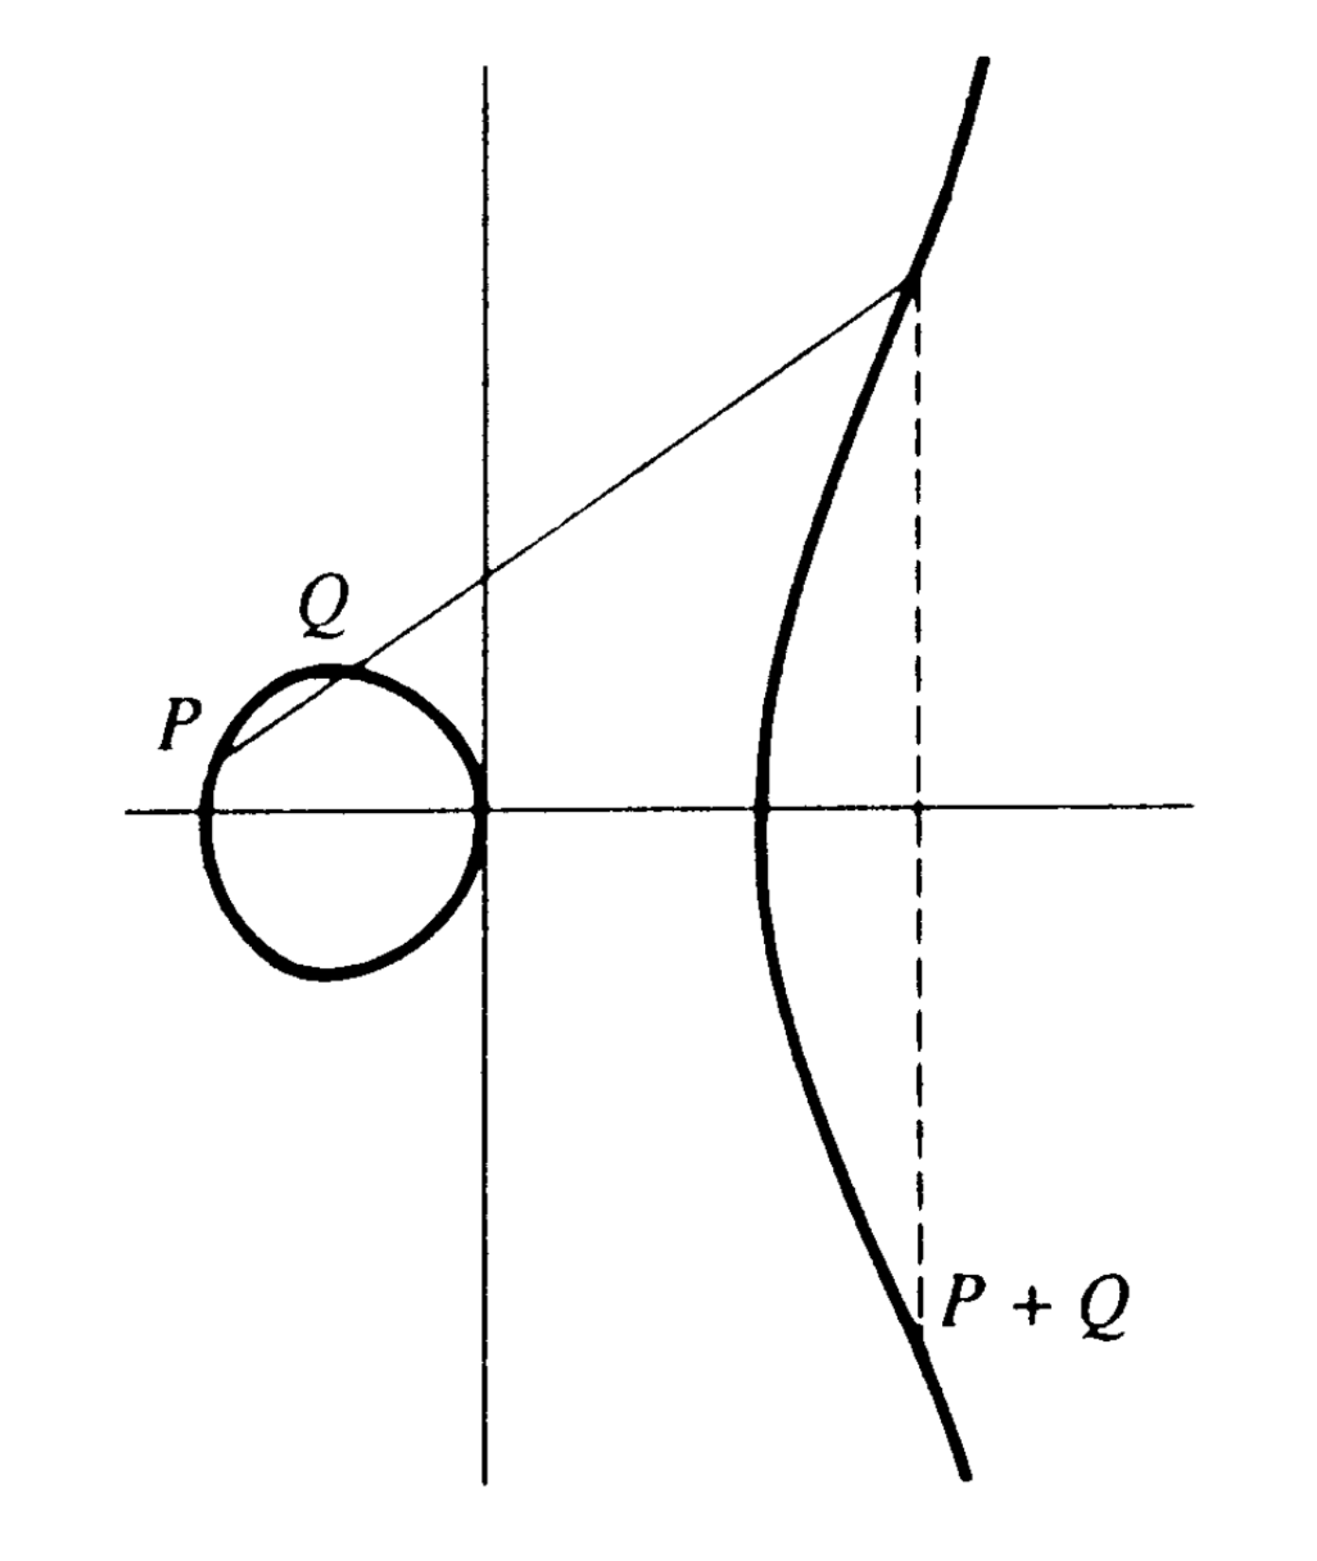
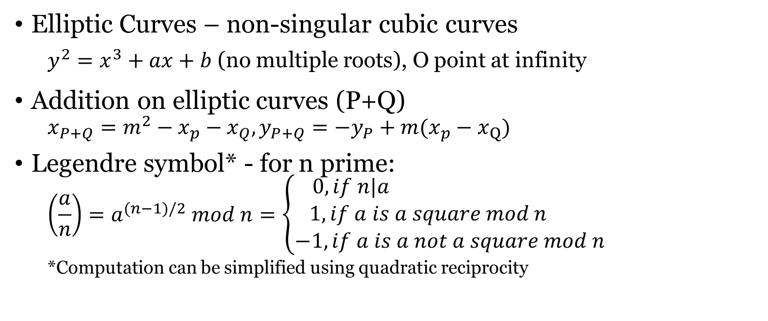
Background
Elliptic Curves – non-singular cubic curves
$y^{2}=x^{3}+ax+b$ (no multiple roots), O point at infinity
Addition on elliptic curves (P+Q)
$$x_{P+Q}=m^{2}−x_{p}−x_{Q}, y_{P+Q}=−y_{P}+m(x_{p}−x_{Q})$$
Legendre symbol* - for n prime:
$$\left(\frac{a}{n}\right)=a^{(n−1)/2} mod n=\left\{\begin{aligned}0, if n|a \\ 1, if a is a square mod n \\ −1, if a is a not a square mod n\end{aligned}\right.$$
*Computation can be simplified using quadratic reciprocity

Slide 3
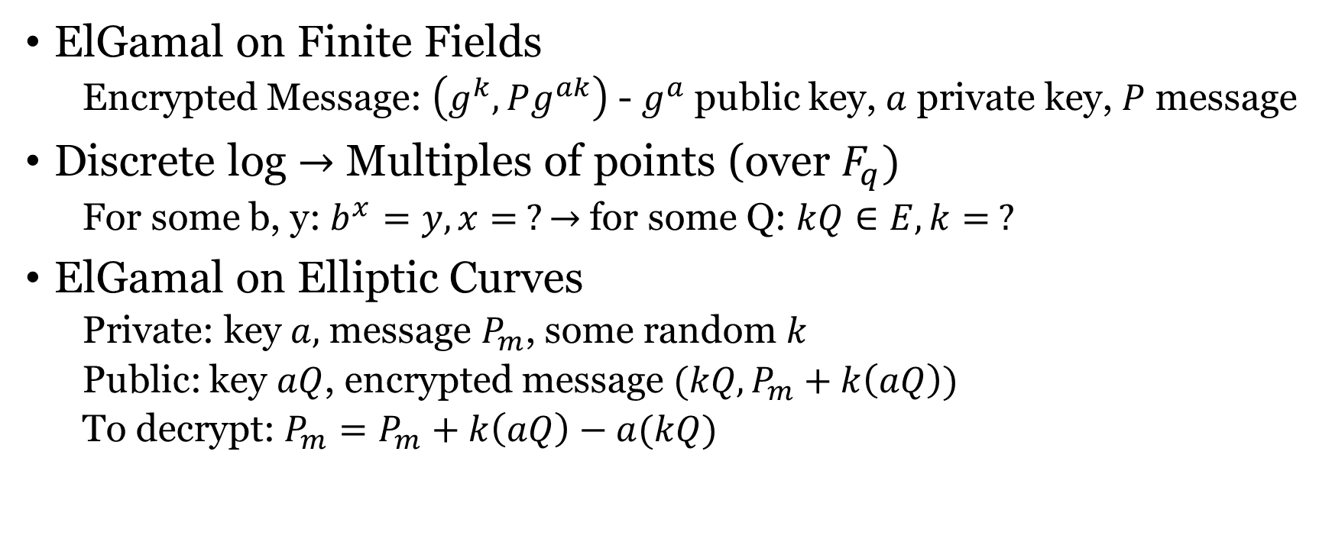
ElGamal on Elliptic Curves
ElGamal on Finite Fields
Encrypted Message: $\left(g^{k},Pg^{ak}\right)$ - $g^{a}$ public key, $a$ private key, $P$ message
Discrete log $→$ Multiples of points (over $F_{q})$
For some b, y: $b^{x}=y, x= ?→$ for some Q: $kQ∈E, k= ?$
ElGamal on Elliptic Curves
Private: key $a,$ message $P_{m}$, some random $k$
Public: key $aQ$, encrypted message $(kQ,P_{m}+k\left(aQ\right))$
To decrypt: $P_{m}=P_{m}+k\left(aQ\right)−a(kQ)$

Slide 4
Example – Encoding the Letter “S”
“1” = 0, … , “0” = 9, “A” = 10, … , “Z” = 35
Number of chances to look for valid ${\left(y^{∗}\right)}^{2}$: $κ=20$
E = $y^{2}+y=x^{3}−x$ over the field of $p=751$elements
$y^{∗}=y+376: E→{(y^{∗})}^{2}=x^{3}−x+188$
“S” = 28, cycle through $x=κ"S"+j, j∈[1,κ]$
$j=1→x=561→{\left(y^{∗}\right)}^{2}=261→\left(\frac{261}{751}\right)=−1$
$j=2→x=562→{\left(y^{∗}\right)}^{2}=598→\left(\frac{598}{751}\right)=1$
$y^{∗}=\sqrt{598}=201$
S $→(562, 201)$

Slide 5
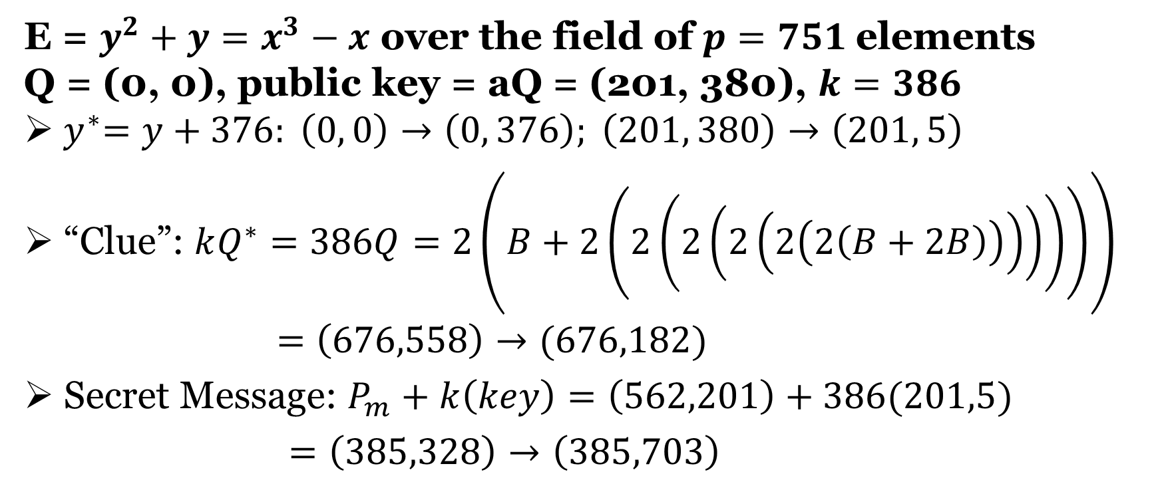
Example – Encrypting “S” w/ Elliptic ElGamal
E = $y^{2}+y=x^{3}−x$ over the field of $p=751$elements
Q = (0, 0), public key = aQ = (201, 380), $k=386$
${ y}^{∗}=y+376: \left(0, 0\right)→\left(0, 376\right); \left(201, 380\right)→\left(201, 5\right)$
“Clue”: $kQ^{∗}=386Q=2\left(B+2\left(2\left(2\left(2\left(2\left(2\left(B+2B\right)\right)\right)\right)\right)\right)\right)$
$=\left(676,558\right)→(676,182)$
Secret Message: $P_{m}+k\left(key\right)=\left(562,201\right)+386(201,5)$
$=\left(385,328\right)→\left(385,703\right)$

