Slide 1
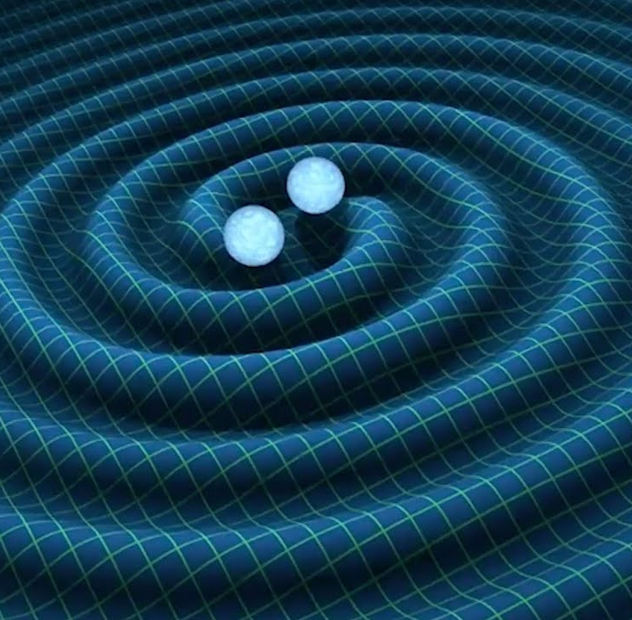
Gravitational Waves using Einstein’s equation
Sophie Kadan

Slide 2
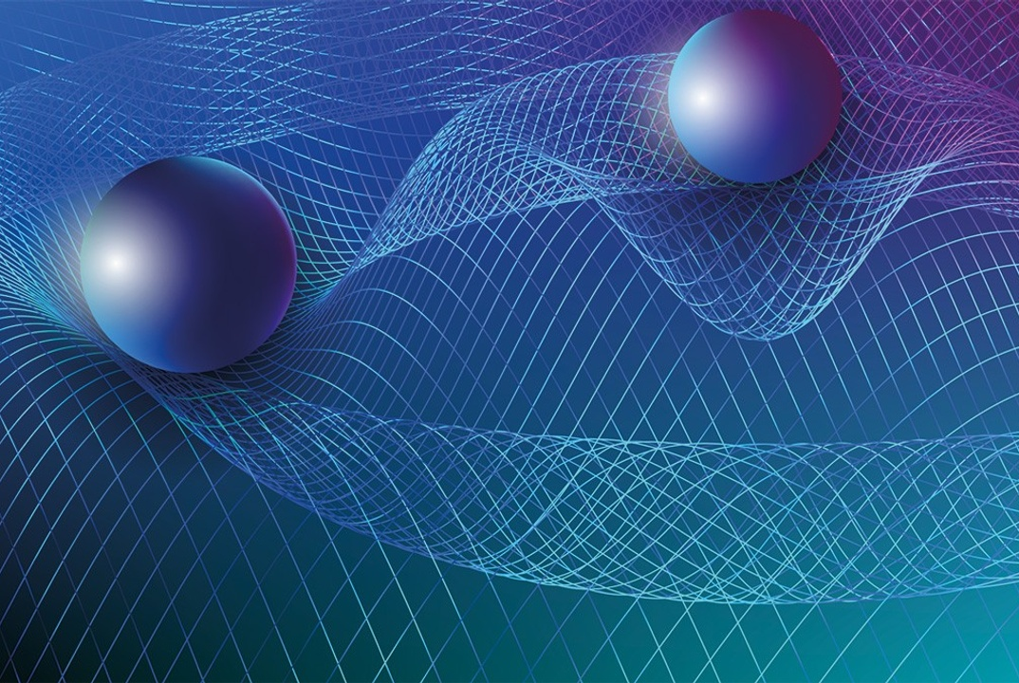
Flat and Curved Spacetime
In general relativity, gravity described as curvature of spacetime
Comes from Weak Equivalence Principle
In small enough regions of spacetime, the motion of freely-falling particles are the same in a gravitational field and a uniformly accelerated frame
Einstein updated this in the Einstein Equivalence Principle
In small enough regions of spacetime, rules of gravity reduce to those of special relativity
it is impossible to detect the existence of a gravitational field by means of local experiment

Slide 3
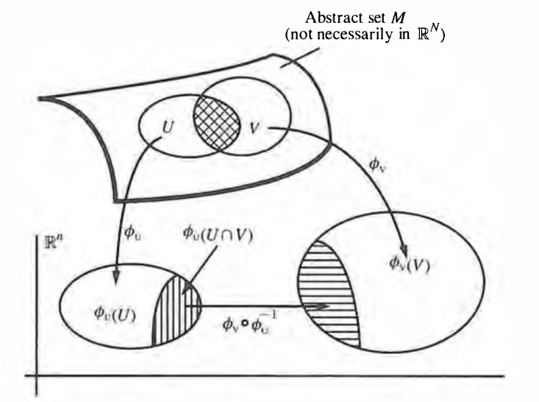
Smooth Manifolds
Complex topological objects of dimension n
Made up of smoothly sewn patches that can locally be mapped to R^{n}

Slide 4
Tensors
Multilinear maps from collection of tangent vectors and cotangent vectors to real numbers
Coordinate transformations preserve physical meaning (invariant)
Rank 1 tensors are vectors and rank 2 tensors are square arrays
Tensor transformation law

Slide 5
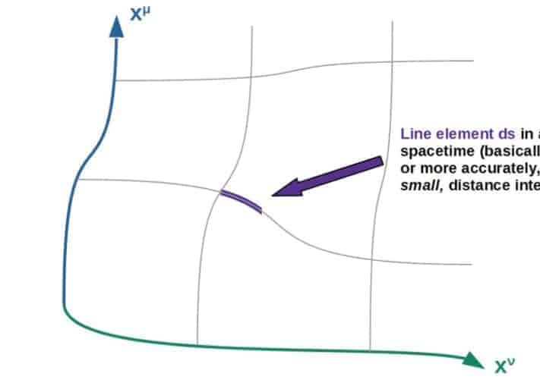
Metric Tensor
Rank 2 tensor, symmetric
Measurement of how much the basis vectors align with each other
Allows for computation of path length, shortest distance between points
=
Line element of 2-sphere with radius 1 in (θ, Φ) coordinates

Slide 6
Covariant Derivatives
Covariant derivative allows us to define instantaneous rate of change of a tensor field along manifold
Transforms like a tensor
Equal to coordinate derivative plus correction (Christoffel symbol), allowing it to transform like a tensor
For Levi-Cevita connection, Christoffel symbols are defined in terms of metric
Accounts for change in basis vectors along manifold
Geodesic Equation
Coordinate derivative
Christoffel symbol

Slide 7
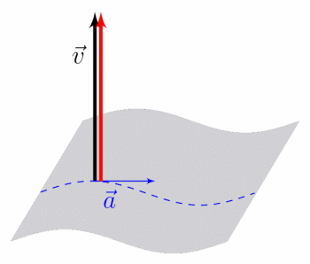
Covariant Derivatives
Parallel Transport: translating tangent vector across curved manifold
Geodesic: curve whose tangent vector is parallel-transported along itself, creating least-distance path
https://www.google.com/url?sa=i&url=https%3A%2F%2Fwww.naturelovesmath.com%2Fen%2Fmathematical-physics%2Fgeneral-relativity-loud-and-clear%2F&psig=AOvVaw1FshgRSGXJVM5LFNQD6HEL&ust=1669846970408000&source=images&cd=vfe&ved=0CBAQjhxqFwoTCKCspfG21PsCFQAAAAAdAAAAABAI

Slide 8
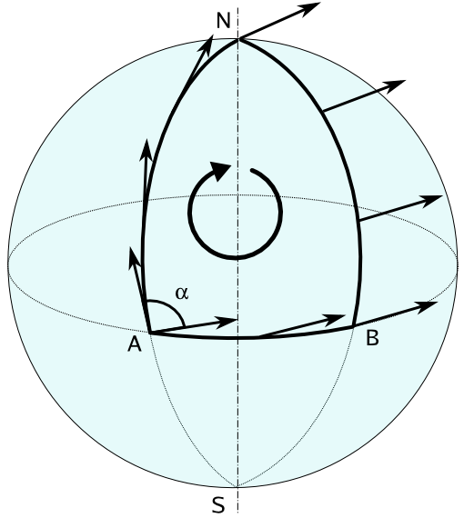
Riemann Curvature Tensor
Riemann tensor quantifies the curvature of a manifold
Measures difference in vector when transported around a closed loop

Slide 9
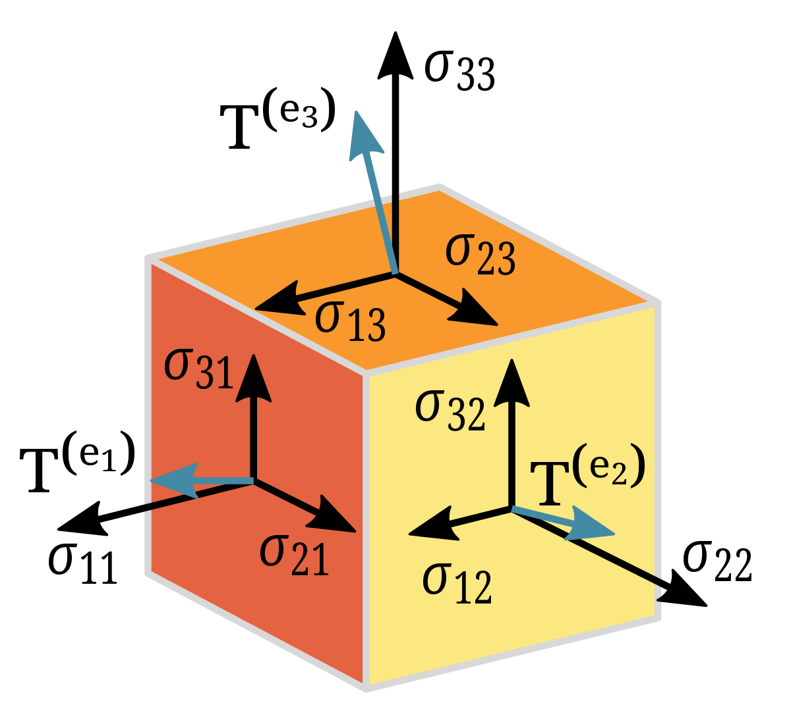
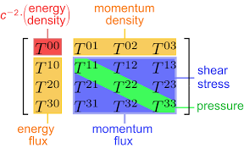
Important Tensors: Stress-Energy (Energy-Momentum) Tensor
Explains how energy and momentum distributed around spacetime and how they flow
Density and flux of energy and momentum are sources of gravitational field
=

Slide 10
Generalizing Newtonian Gravity with Einstein’s Equation
Einstein Tensor: Describes structure of spacetime, built from second derivatives of the metric
Einstein Equation: Relates stress-energy tensor to the curvature of spacetime
Contracted indices of Riemann tensor
Notes:
E = mc2
Have mass, giving energy to system on right hand side
Left hand says by having energy in ssyetm, results in curvature

Slide 11
Applications: Linearized Gravity
Perturbation theory allows us to approximate solution to Einstein’s equation when the gravitational field is weak
We first approximate metric tensor as flat space plus small perturbation:
Now,
and
Notes:
Solve for perturbation, which simplifies

Slide 12
Applications: Linearized Gravity (cont.)
The Einstein tensor now reduces to
,
a linear, second-order PDE!
Linearized gravity models gravitational waves
Vacuum solutions model waves propagating through spacetime

Slide 13
Deriving Gravitational Waves
To simplify equation, rewrite perturbation as its trace-reversed version
,
where
In vacuum, the Einstein equation then becomes ,
a system of 10 linearly-independent wave equations
Notes:
Vacuum , T= 0, wave equation is bottom specifically propogating through vacuum

Slide 14
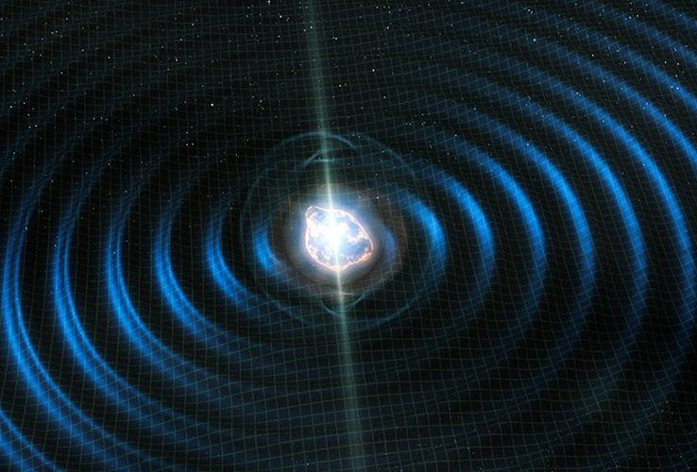
Production of Gravitational Waves
Continuous gravitational waves can be produced by spinning massive objects
Imperfections in spherical shape of star generate gravitational waves during spin
Binary star systems generate waves similarly
Bumps in system’s mass distribution during spin creates “spherical inconsistencies”
Notes:
How do you get? Add source, set equal to stress tensor instead of 0.

Slide 15
Effect of Gravitational Waves
Different gravitational wave polarizations create different oscillations of matter!
Notes:
Polarizations = solve for huv matrix, answer setting certain independent components = 0
Answers whats the measurable effect of this
Warps moving particles

