Slide 1
Quadratic Reciprocity
Jack Blackman, Class of 2024

Slide 2
Background and Definitions

Slide 3
What is Quadratic Reciprocity?
The law of Reciprocity is a fundamental result of number theory
Way to determine if a congruence, $x^{2}≡a \left(mod p\right)$ is solvable (under real numbers)
Has > 250 different proofs, with Gauss providing 8 in 1801 and new proofs still being discovered
Notes:
Lots of cool proofs that we went through; but they are complicated and would take nearly the whole talk so going to avoid them for now, but will link to some of my favorite at the end

Slide 4
Basic Concepts & Symbols
Definition: If p is an odd prime, a and p are relatively prime, then a is a quadratic residue (mod p) if $x^{2}≡a$ (mod p) is solvable. If this is not solvable, then a is a non-quadratic residue
Legendre symbol, $(\frac{a}{p}),$is defined by:
$$(\frac{a}{p})=\left\{\begin{aligned}1 if a is a quadratic residue (mod p) \\ −1 if a is a non−quadratic residue (mod p) \\ 0 if a|p\end{aligned}\right.$$

Slide 5
Example 1 – Quadratic Residues (mod 17)
In Mod 17 we have:
$$1^{2}≡{16}^{2}≡1$$
$$2^{2}≡{15}^{2}≡4$$
$$3^{2}≡{14}^{2}≡9$$
$$4^{2}≡{13}^{2}≡16$$
$$5^{2}≡{12}^{2}≡8$$
$$6^{2}≡{11}^{2}≡2$$
$$7^{2}≡{10}^{2}≡15$$
$$8^{2}≡9^{2}≡13$$
What are the Quadratic Residues?

Slide 6
Example 1 (CON’T) – Quadratic Residues (mod 17)
For p = 17, the quadratic residues are:
1,2,4,8,9,13,15,16
Can we generalize to test if a is a quadratic residue (mod p)?

Slide 7
Euler’s Criterion
If p is an odd prime and (a,p) = 1, then
$x^{2}≡a \left(mod p\right)$ is solvable if and only if, $a^{\frac{p−1}{2}}$ $≡$ 1 (mod p)
$x^{2}≡a \left(mod p\right)$ is not solvable if and only if, $a^{\frac{p−1}{2}}$ $≡−1$ (mod p)

Slide 8
Quadratic Reciprocity
If p and q are distinct odd primes, then
($\frac{p}{q})$ ($\frac{q}{p})$= ${(−1)}^{\frac{(p−1)(q−1)}{4}}$
Some supplementary results: If p is an odd prime, then
$(\frac{−1}{p})=\left\{\begin{aligned}1 if p≡1 \left(mod 4\right) \\ −1 ifp≡−1 \left(mod 4\right)\end{aligned}\right.$
$(\frac{2}{p})= {(−1)}^{\frac{p^{2}−1}{8}}$
Notes:
Stated in words: if p or q are of the form 4k+1, then both congruences $x^{2}≡q \left(mod p\right)$ & $x^{2}≡p \left(mod q\right)$ are solvable or both are not. If p and q are of the form 4k+3, then one is solvable and the other is not.

Slide 9
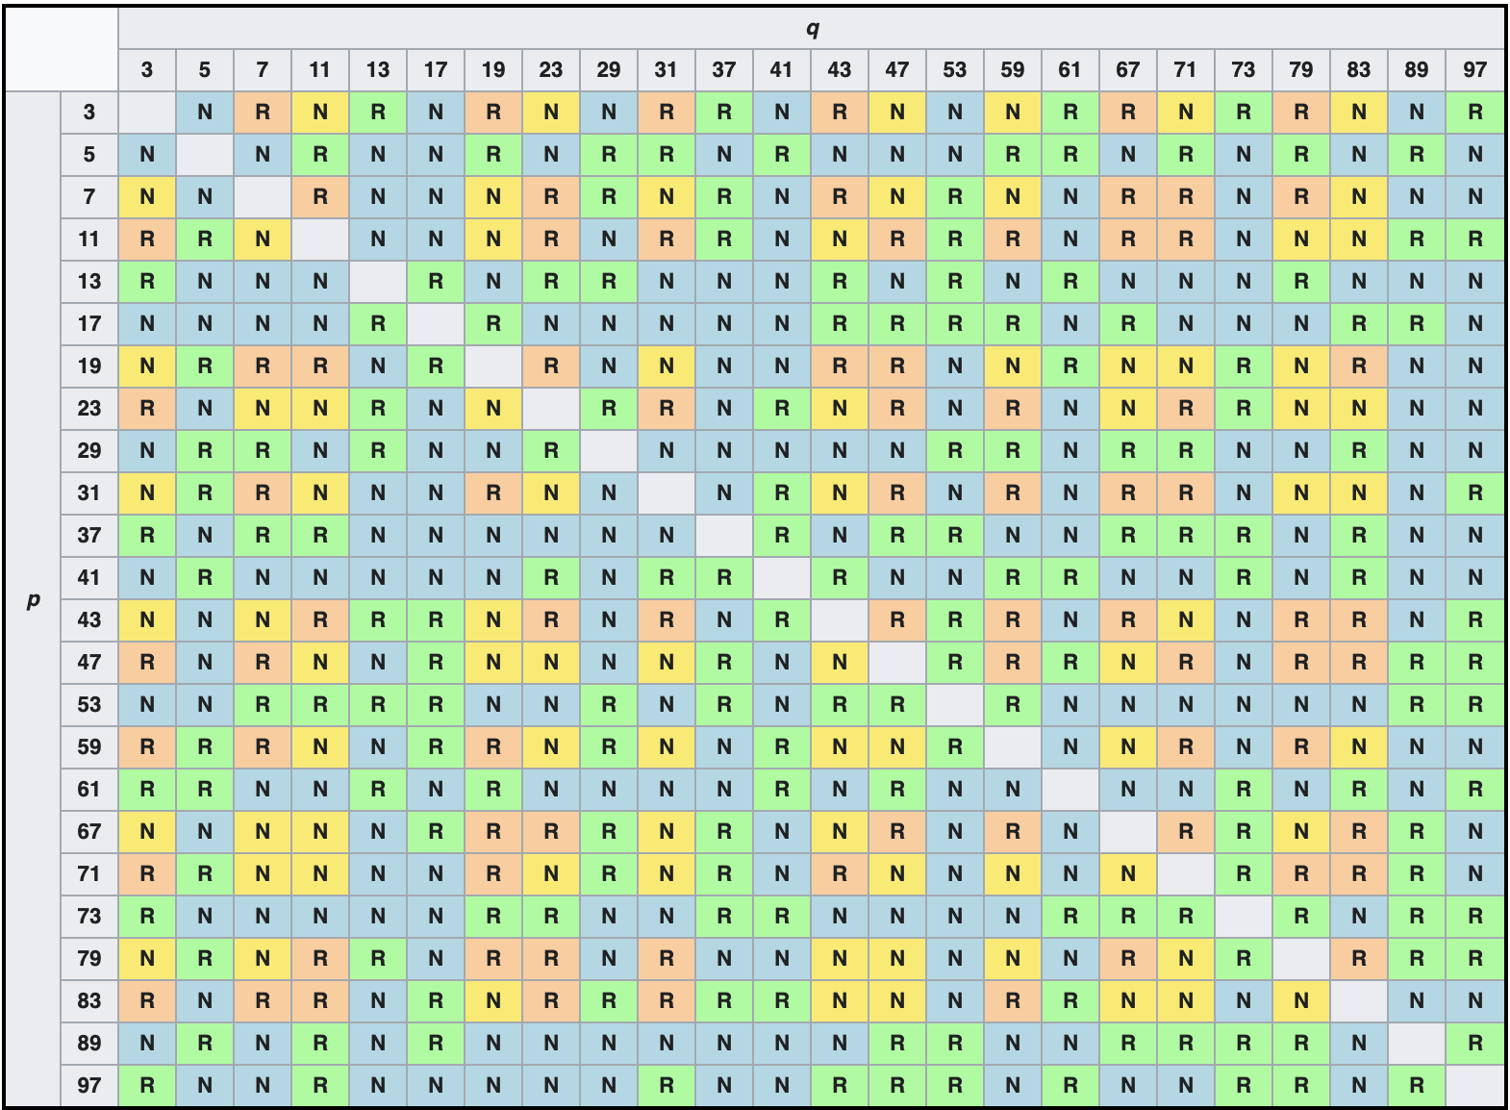
Visualizing Quadratic Reciprocity
The following table (with all primes up to 100) shows a good depiction of which primes are quadratic residues mod the other primes
Per Quadratic Reciprocity, the blue and green entries are symmetrical across the diagonal, while the the orange and yellow entries are anti-symmetrical
Notes:
The blue and green entries are symmetric around the diagonal: The entry for row p, column q is R (resp N) if and only if the entry at row q, column p, is R (resp N).
The yellow and orange ones, on the other hand, are antisymmetric: The entry for row p, column q is R (resp N) if and only if the entry at row q, column p, is N (resp R).
The reciprocity law states that these patterns hold for all p and q.

Slide 10
Example 2 – Is 150 a quadratic residue mod 1009?
$x^{2}≡150 \left(mod 1009\right)$ → ($\frac{150}{1009})= ???$
($\frac{150}{1009})=$ ($\frac{2}{1009}$) ($\frac{3}{1009}$) ($\frac{5}{1009}$) ($\frac{5}{1009}$)
($\frac{2}{1009}$) = ${(−1)}^{\frac{{1009}^{2}−1}{8}}=1$
($\frac{3}{1009}$) = ${\text{(}\frac{1009}{3}\text{)}(−1)}^{\frac{1009−1}{2}}=$ ${\text{(}\frac{1}{3}\text{)}(−1)}^{504}$ = 1
($\frac{5^{2}}{1009}$) = 1
$∴$($\frac{150}{1009})$ = 1, so 150 is a quadratic residue mod 1009
Notes:
Way easier to test big things modulo small things than testing small things with higher modulo – showing the benefits of quadratic reciprocity to simplyifing equations; QR lets us break down the 150 and then use it with the local primes/pieces of 150; highlight the second line with 3 on 1009, using it on the smaller primes to answer the questions

Slide 11
Applications

Slide 12
Applications
Quadratic Reciprocity is a necessary building block within number theory and furthering our understanding of greater mathematics.
Ex: Use the results of quadratic reciprocity in the proof of:
Special Cases of Dirichlet’s theorem
if (a,q) = 1 then there are infinitely many primes $≡$ a (mod q)
Fermat’s theorem on sum of two squares
Any prime number $≡$ 1 (mod 4) can be expressed as the sum of two squares

Slide 13
Special Cases of Dirichlet’s Theorem
Quadratic Reciprocity can be used to prove a lemma needed for the following cases:
5k+4, 8k+3, & 12k+11
Example Lemma (Can be generalized):
If p is prime s.t. (p,5) = 1, then ($\frac{5}{p})=1$if and only if $p≡1 or 4 \left(mod 5\right)$
By Quadratic Reciprocity,
($\frac{5}{p})={(−1)}^{p−1}$ ($\frac{p}{5})$→ ($\frac{p}{5})$= $\left\{\begin{aligned}1 if p≡1 or 4\left(mod 4\right) \\ −1 if≡2 or 3 \left(mod 4\right)\end{aligned}\right.$
Notes:
Know how to finish the proof: use this result by assuming finite number of primes, use them to construct new number by taking 2 x the product of the squares and examine that mod 5 (and will again use the fact that there are quadratic residues)

Slide 14
Generalizing Quadratic Reciprocity -
Quadratic Reciprocity over the integers can be generalized further to the following rings:
Gaussian Integers
Eisenstein Integers
Imaginary Quadratic Fields
Polynomials over a finite field
Artin Reciprocity
Notes:
What exactly is reciprocity is a deep questions that is at the forefront of mathematics and still being uncovered

Slide 15
Thank you! And a special thanks to Souparna Purohit for all of his guidance and support

Slide 16
Sources
Almuteri, Awatef Noweafa, "Quadratic Reciprocity: Proofs and Applications" (2019). Electronic Theses and Dissertations. 1540. https://egrove.olemiss.edu/etd/1540
http://ramanujan.math.trinity.edu/rdaileda/teach/f20/m3341/lectures/lecture19_slides.pdf
https://crypto.stanford.edu/pbc/notes/numbertheory/quadrecip.html
https://stacky.net/files/115/RousseauQR.pdf
https://en.wikipedia.org/wiki/Quadratic_reciprocity
https://en.wikipedia.org/wiki/Gaussian_integer

